Slide 1
Ancient Egyptian Wall Paintings

Slide 2



Pictures and paintings tell us a lot about people and their lives - both today and in the past. Our homes and art galleries have many pictures but they can also be found in all sorts of different places.
Here the paintings were found on the walls of caves.
They were made thousands of years ago.
This painting (believed to be Banksy) was found on the
o an outside wall of a house.
These pictures were drawn on a street pavement.

Slide 3
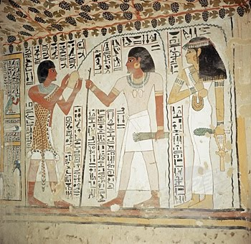
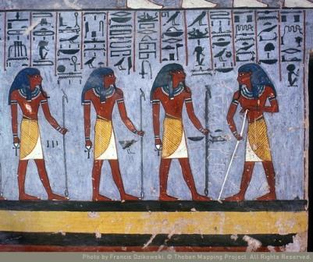
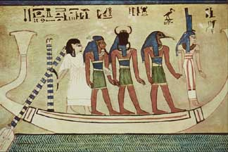
Where do you think these pictures were found?

Slide 4
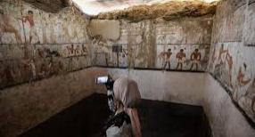
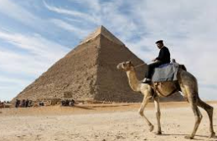
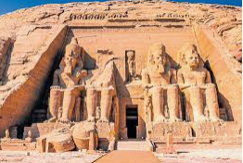
The pictures were found on the tomb walls of rich and powerful Ancient Egyptians. Tombs were places where Egyptian people were buried when they died. These paintings were there to help the dead person in the afterlife (life after death).

Slide 5
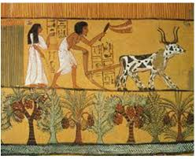
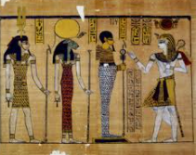
When you look at Egyptian paintings (and carvings) you’ll notice that the face is always sideways, the upper body always faces forward, and the legs and feet face sideways. This is not a natural position.
You’ll also notice that the one eye that shows is always painted on the side of the face.

Slide 6

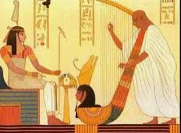
A lot of what we know about the Ancient Egyptians comes from their art. We can learn things such as what they looked like, what kind of clothes they wore, what jobs they did and what they considered to be important from their art.
A lot of what we know about the Ancient Egyptians comes from their art. We can learn things such as what they looked like, what kind of clothes they wore, what jobs they did and what they considered to be important from their art.

Slide 7
Your task today is to draw either a picture of an Ancient Egyptian (person or god) or if you prefer, a drawing of their head only. Can you remember the rules?
The Rules
The chest and eye are drawn as if looking at the person from the front.
The hips, legs and head of the person are drawn as if looking at them from the side.
Men were drawn with one foot in front of the other.
Women were drawn with their feet together.
Servants were drawn smaller than a King.
The size of the head, the body and the length of the legs were always the same.
The following slides should give you some help! You can also follow this youtube clip:
https://www.youtube.com/watch?v=SGVtcCGBbEI

Slide 8
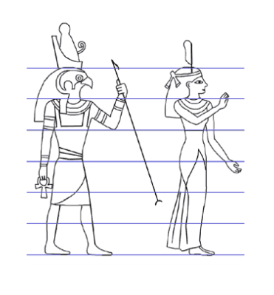

Slide 9
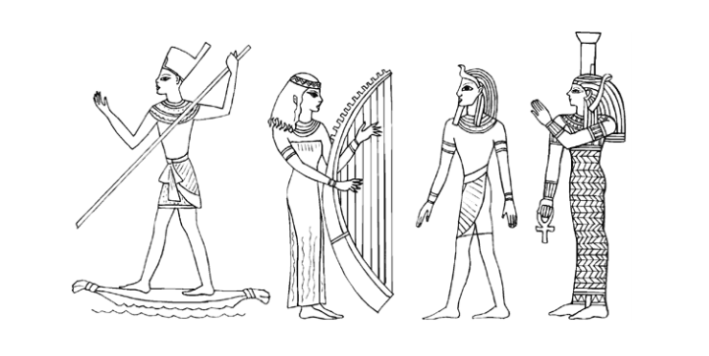
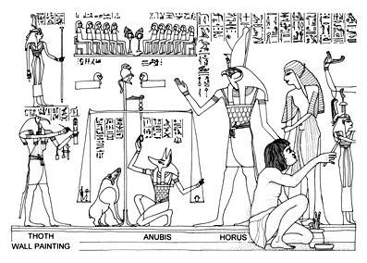

Slide 10
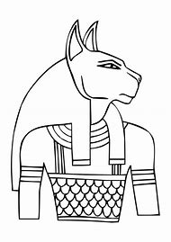
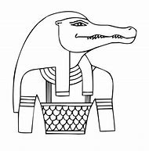

Slide 11
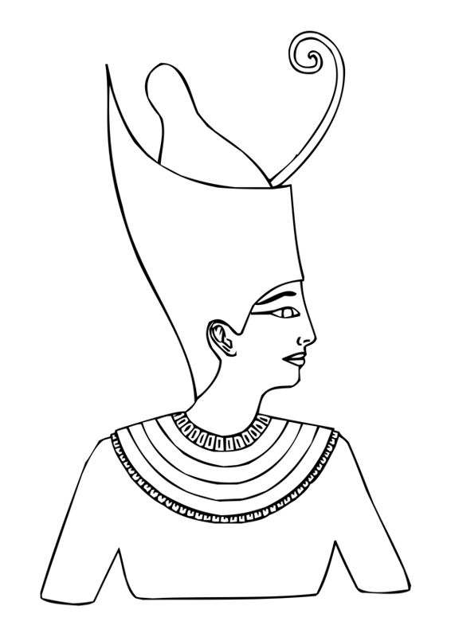
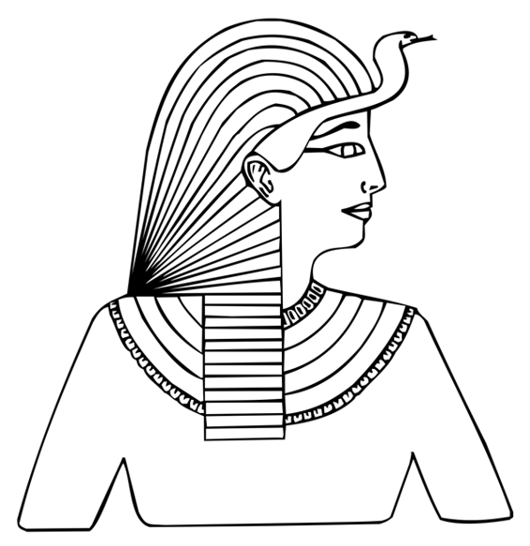

Slide 12


