Slide 1
Animals and Nutrition

Slide 2
What do we mean by nutrition?
Nutrition is the process of providing or obtaining the food necessary for health and growth.

Slide 3
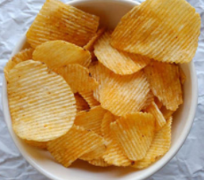
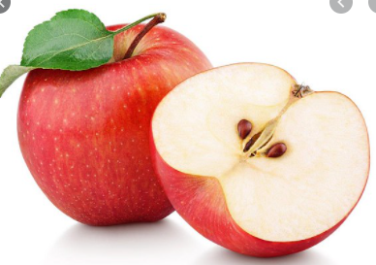
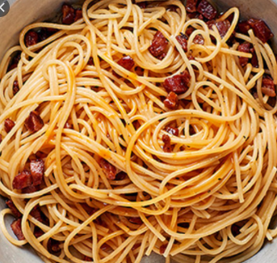
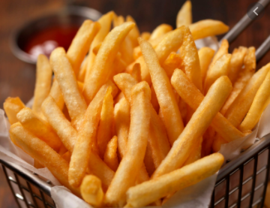
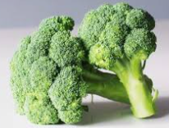
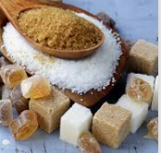
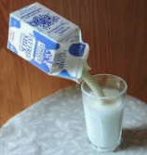
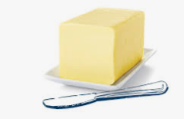
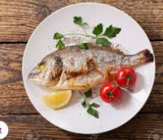
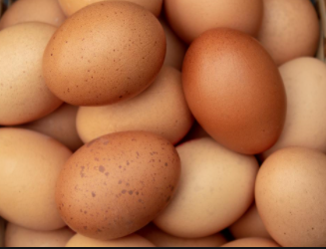

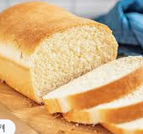
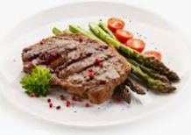
Hmmm…….food! Can you sort these different foods into groups? Can you explain why you have sorted them in this way?

Slide 4
What types of food do animals including humans need for health and growth?
Can you make a list of the different foods we need in order to stay healthy and that help us grow?

Slide 5
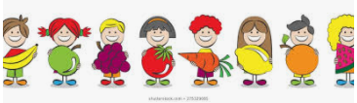
What types of food do animals including humans need for health and growth?
Can you make a list of the different foods we need in order to stay healthy and that help us grow?
Here are some of the foods we need for health and growth:
Fruit and vegetables – which contain many things including natural sugars, fibre, vitamins and minerals
Bread, rice, potatoes, pasta – these contain many things including starch (also known as carbohydrate)
Milk and dairy – these contain many things including fats, vitamins and minerals – particularly calcium.
Meat, fish, eggs, nuts and seeds – these foods contain many things including different types of fats and protein.
A balanced diet should contain all of these different nutrients –
fats, carbohydrates and proteins, as well as vitamins, minerals, water and fibre.
Would you group the food pictures on slide 3 differently now? Why?

Slide 6
What do these types of foods do for our bodies?

Slide 7
What do these types of foods do for our bodies?
Carbohydrates (sugar and starch) are broken down by our bodies to become a source of energy.
Our bodies store fats until they’re needed to give us energy. Fats act as insulation to keep our bodies warm.
Protein is needed for growth and repair. Our muscles, tendons, skin and hair are all made from proteins.
Dairy products contain vitamins, minerals and in particular calcium which helps to build healthy bones and teeth.
Meat and vegetables contain iron which makes the haemoglobin found in our red blood cells.
Now watch: https://www.bbc.co.uk/bitesize/clips/ztr3cdm (It is a bit old-fashioned!)

Slide 8
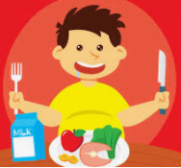
Your tasks for the next seven days…
OVER THE NEXT SEVEN DAYS, KEEP A FOOD DIARY (an example is on the next slide) TO SHOW ALL THE DIFFERENT TYPES OF FOOD THAT YOU EAT THROUGHOUT THE DAY.
START TO COLLECT FOOD AND DRINK LABELS THAT SHOW FATS AND SUGARS CONTAINED IN OUR FOOD THAT WE CAN LOOK AT NEXT TIME.

Slide 9
My Food Diary by________________
DAY | BREAKFAST | Food Types |  | LUNCH TIME | Food Types |  | TEA TIME | Food Types |  | SNACKS | Food Types
Tuesday
Wednesday
Thursday
Friday
Saturday
Sunday
Monday

