Slide 1
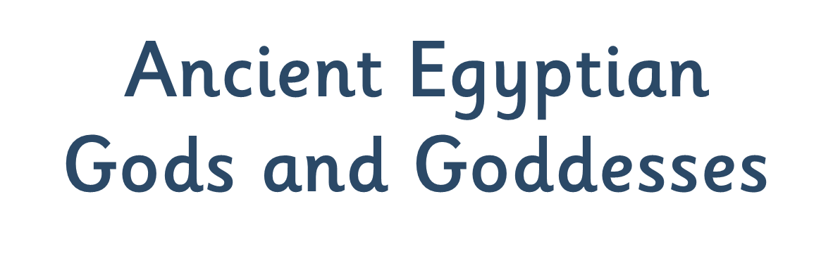


Slide 2
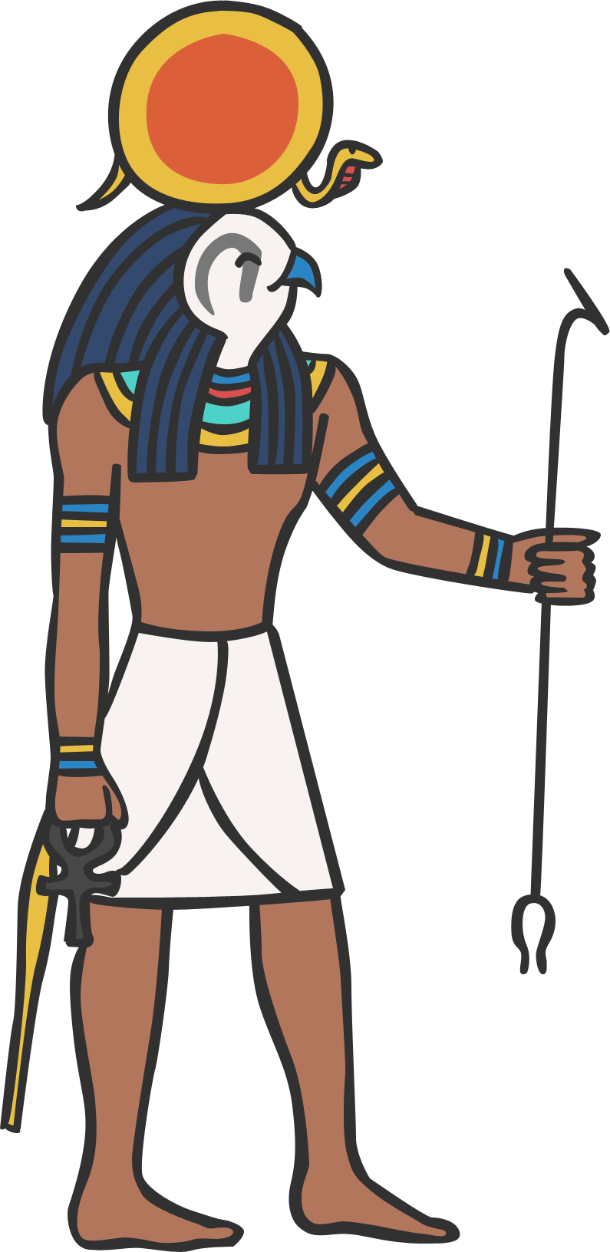
NAME: Ra
GOD OF: the sun
Ra was the most important god to all the Egyptians.
It was believed that he was swallowed by Nut the sky goddess every night and born again in the morning. The Egyptians also believed that Ra travelled through the underworld at night, where he appeared as a man with the head of a ram!

Slide 3
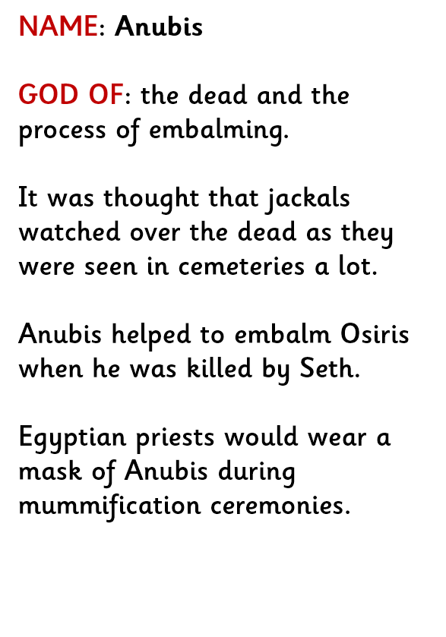
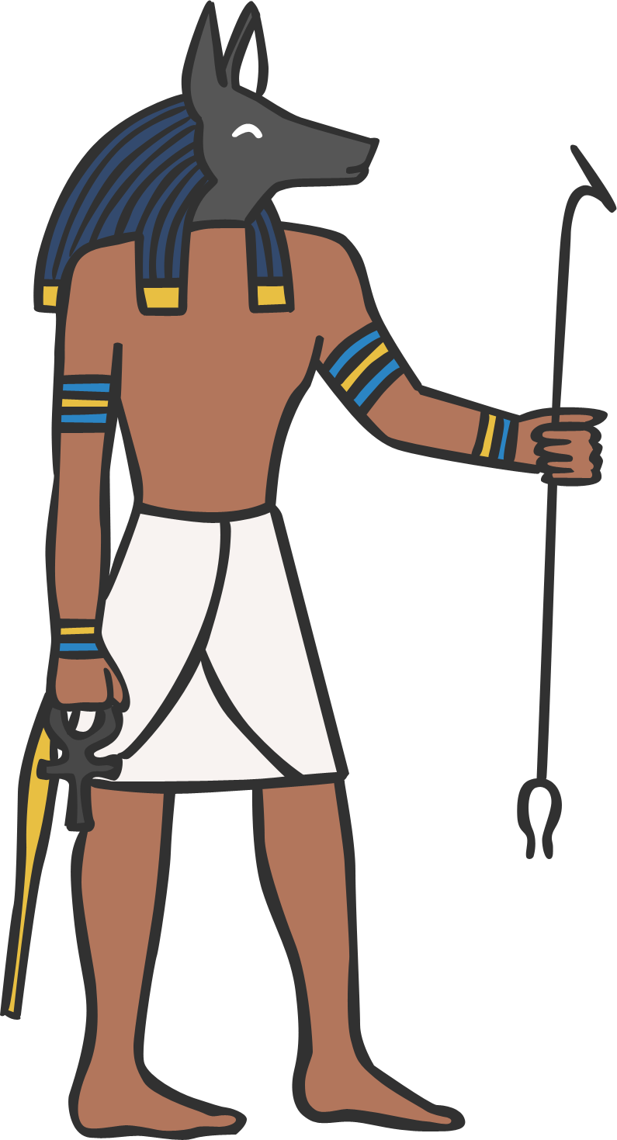

Slide 4
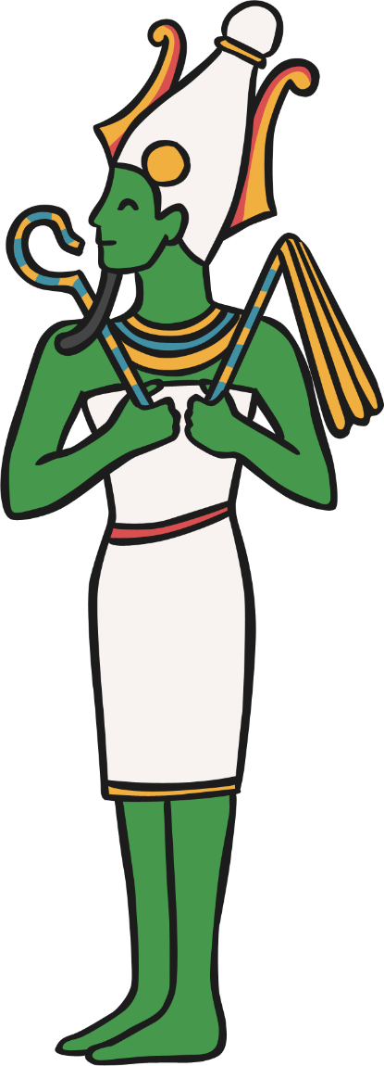
NAME: Osiris
GOD OF: the dead and the underworld.
Osiris was also a god of resurrection and fertility.
The Egyptians believed that he gave them the gift of their most important crop, barley.
Osiris was the husband of Isis and the father of Horus.

Slide 5
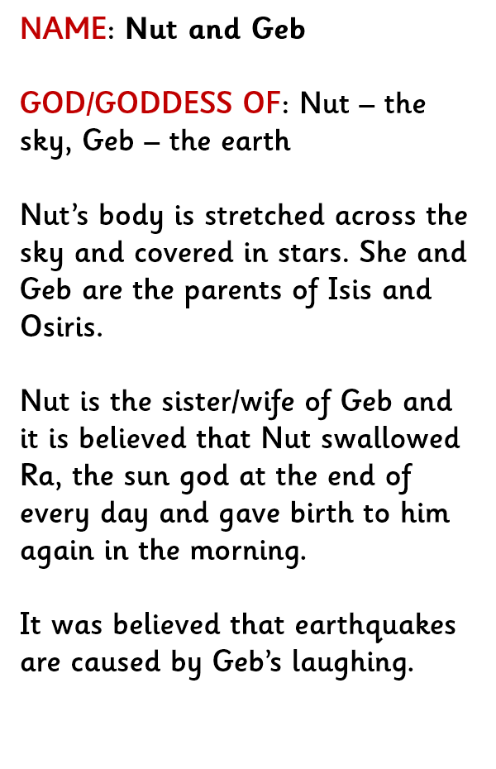
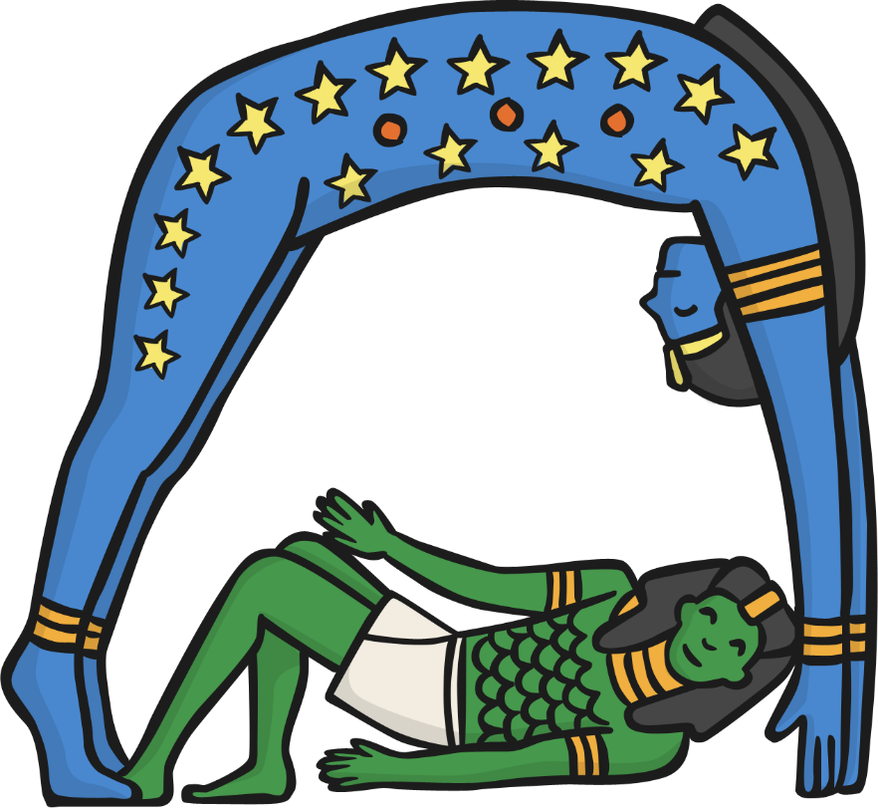

Slide 6
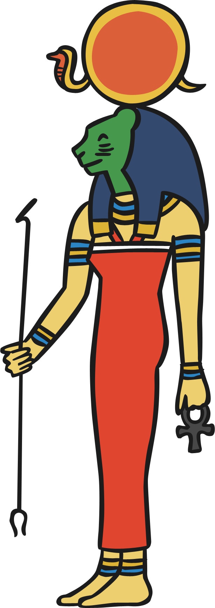
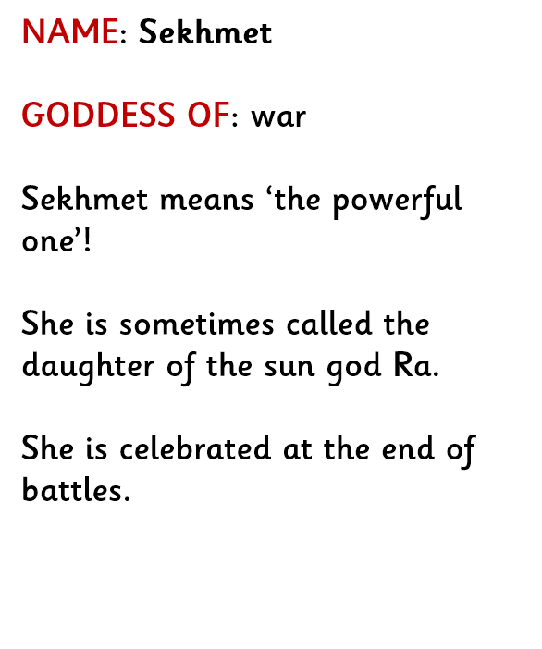

Slide 7
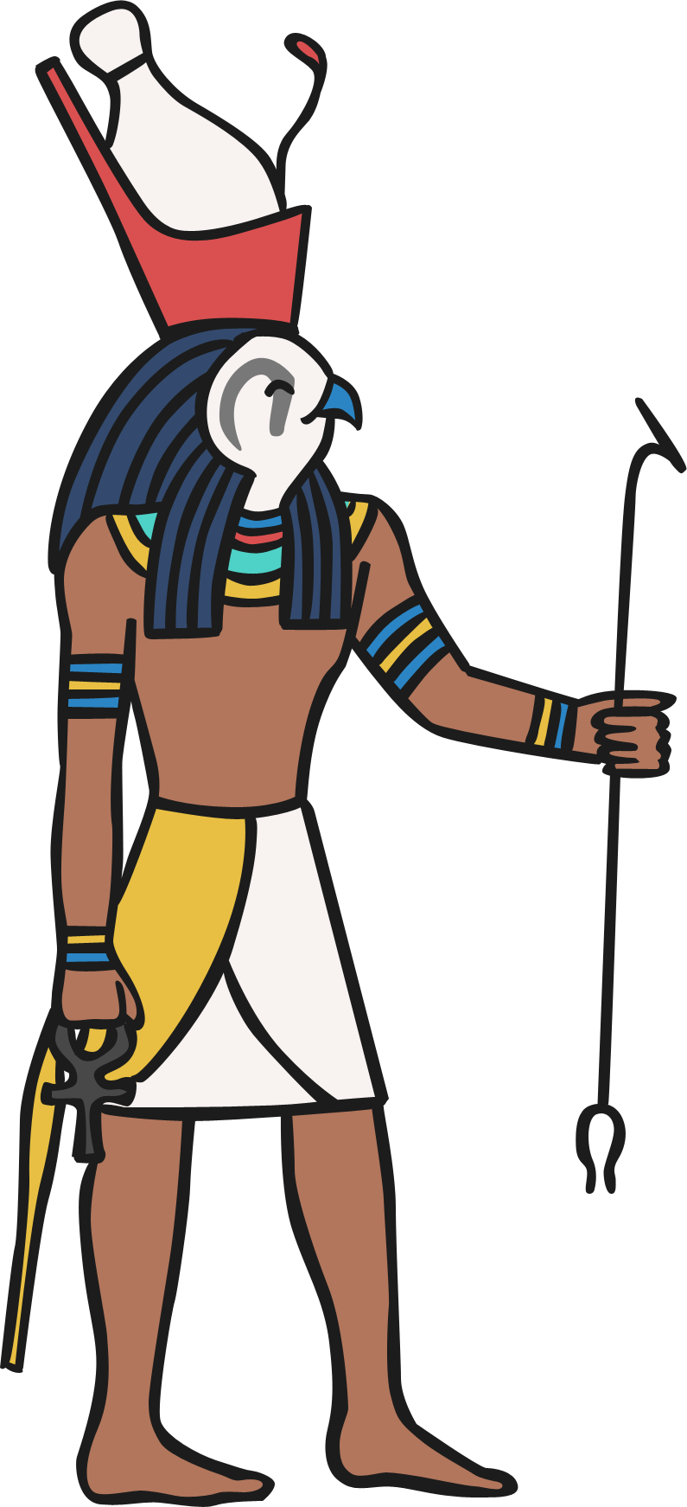
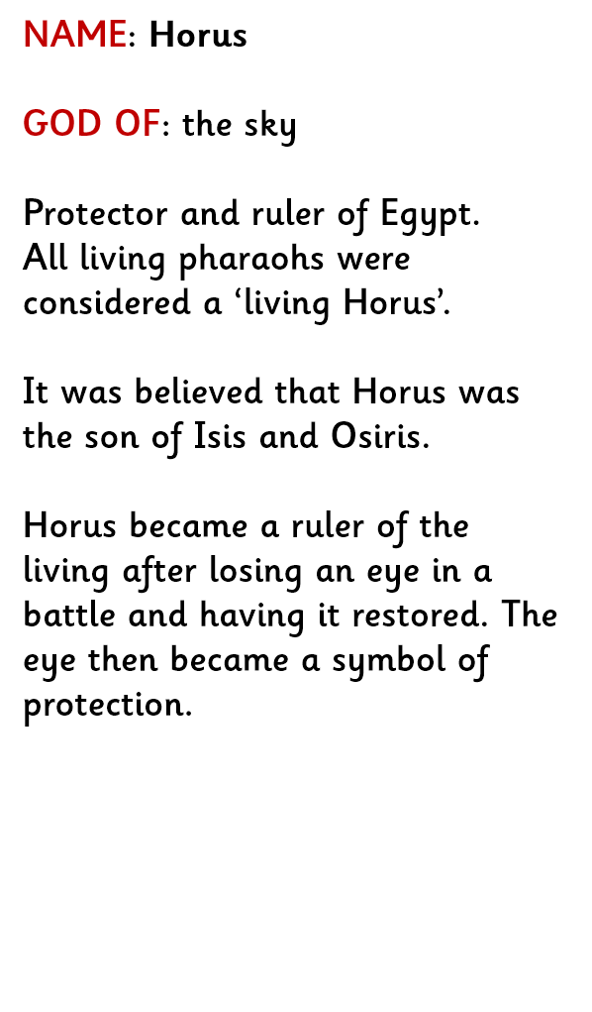

Slide 8
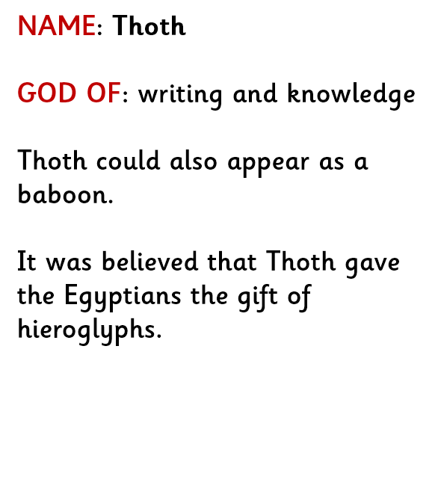
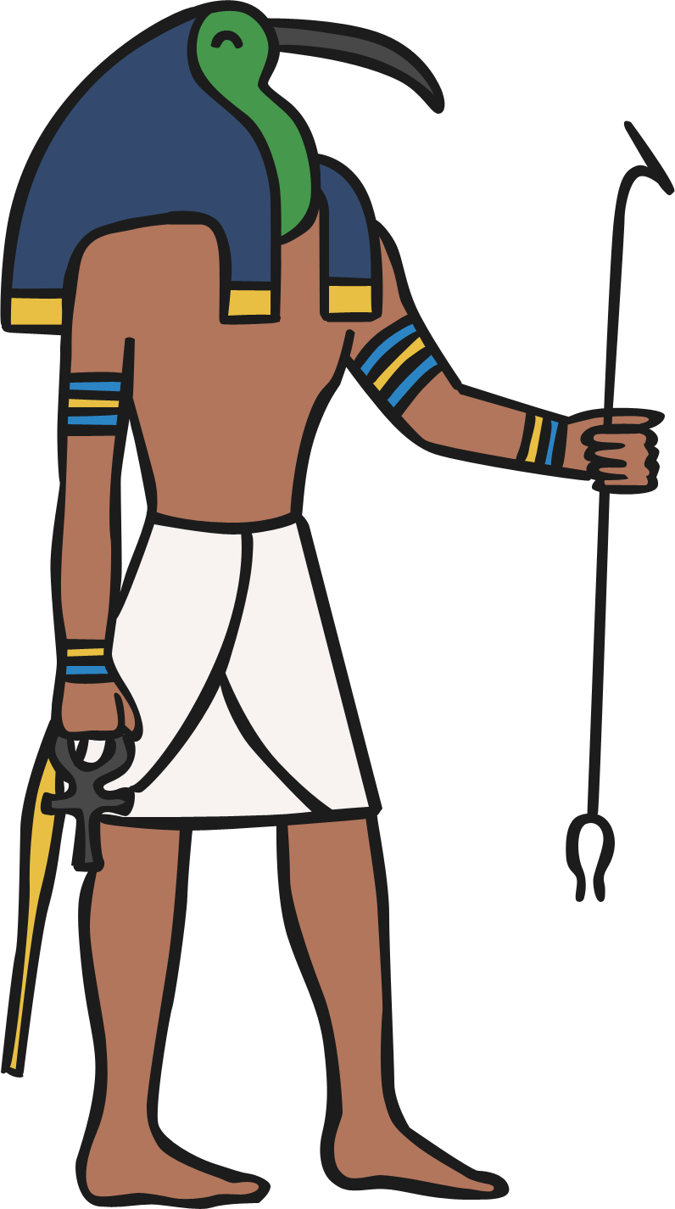

Slide 9


