Slide 1
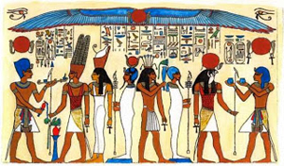
Colours

Slide 2
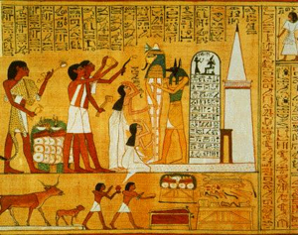
The paint that the Egyptians used was coloured or dyed using minerals that were naturally found in their area and some that they imported. The favourite colours that were used in painting were: red, blue, green, gold, and black; but they also used white, pink and grey. The colours and all of the objects found in tombs were preserved due to the cool dry environment and that’s why we can see them today with such bright tones. Artists would grind the minerals into a fine dust and then mix them with a kind of ‘glue’ made from animals or plants. It was important to make just the right mixture because the paint had to not only stick to the walls, but was designed to last forever.

Slide 3
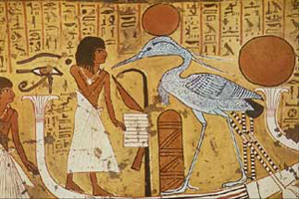
Egyptian artists mixed the colours so that they could show details in the paintings that were closer to real life. Many of the colours had a number of different shades, depending upon what they were going to be used for. Some of the Egyptian gods were also displayed with specific colours. Hapi, the river god was always painted in blue to represent the water. Each of the gods had his or her own specific colour and it included any clothing as well as their skin. Even the god Anubis had his jackal head painted black, because he was the god of the dead. Royalty was often painted with both blue and gold, which were the symbols of strength and power.

Slide 4
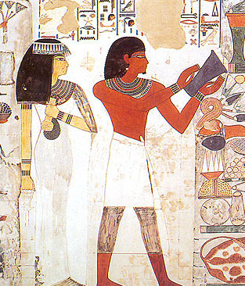
Colours were taken very seriously in ancient Egypt and the colours and tones that they chose for each painting were carefully selected. There were differences in skin tone colour between men and women. Men had a darker reddish brown to reflect their outdoor life and women had a lighter, almost yellow-brown colour to show they lived mostly indoors or in a sheltered location.

Slide 5
Colours and their meanings
Each colour that the ancient Egyptians used was also a symbol, many of these we continue to use today.
Blue called irtiu - represented the sky, water and the heavens. Also represented both birth and rebirth because of the annual flood of the Nile which bought fertility to the land.
Red called desher - this was a powerful colour and was the colour of fire, anger, life, chaos and victory.
Yellow called kenit - represented the sun and everything that was eternal, imperishable and indestructible. Gold was the flesh of the Gods.
White called shesep - was the colour of cleanliness, power, purity and simplicity
Green called wadj - was the colour of vegetation, growth, joy, fertility, new life and regeneration
Black called kem - represented death, night and the afterlife. Anubis, the God of the dead, had a black head. It also represented the regeneration of the land because of the Black lands, the farming areas on the banks of the Nile.

