Slide 1
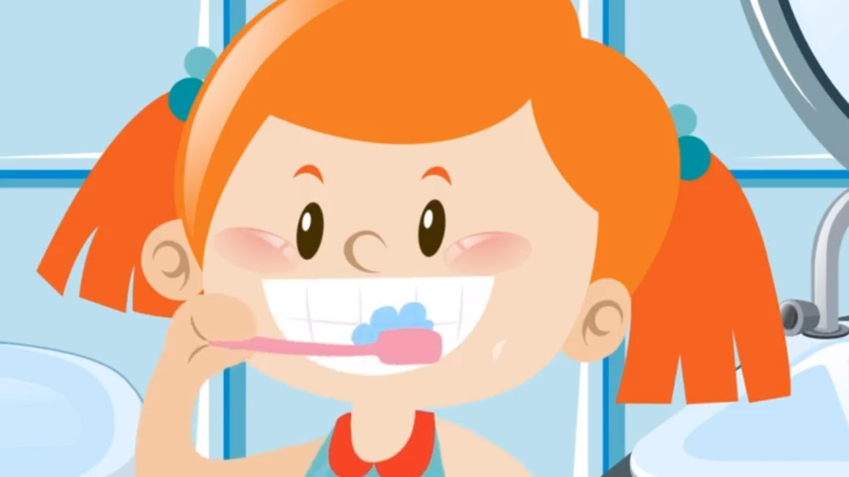
WALT: Look after our teeth

Slide 2
In what ways do you think you can look after your teeth?

Slide 3
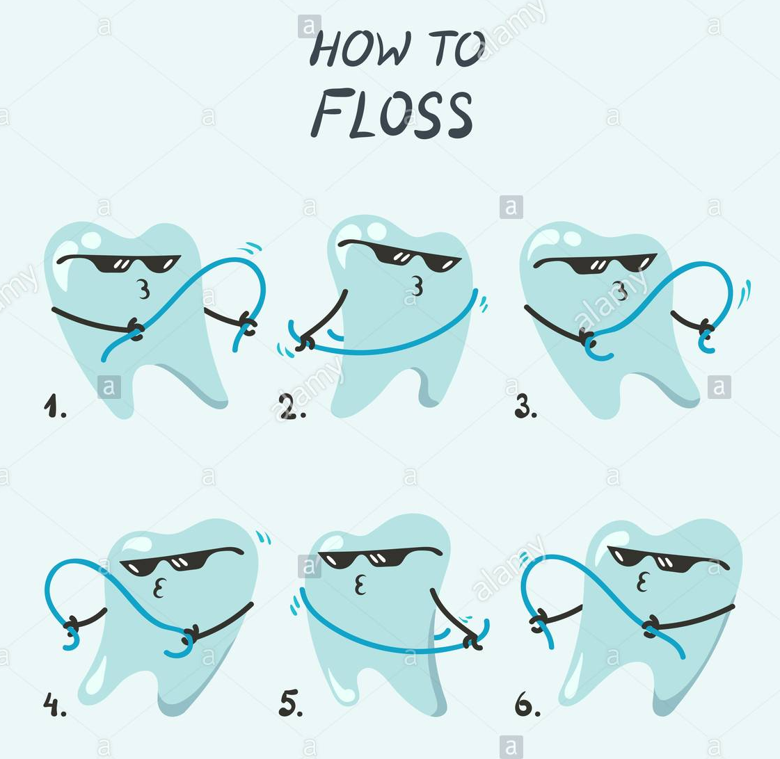
In what ways do you think you can look after your teeth?
Brush your teeth twice a day
Visit the dentist twice a year
Try not to eat or drink too many sugary things
Floss your teeth

Slide 4
What foods are good and what foods are bad for our teeth?
Have a think, perhaps talk to an adult or a sibling if you can.
Have a think about these….
Milk
Fizzy drinks
Sweets
Fruit and vegetables
Cheese
Bread

Slide 5
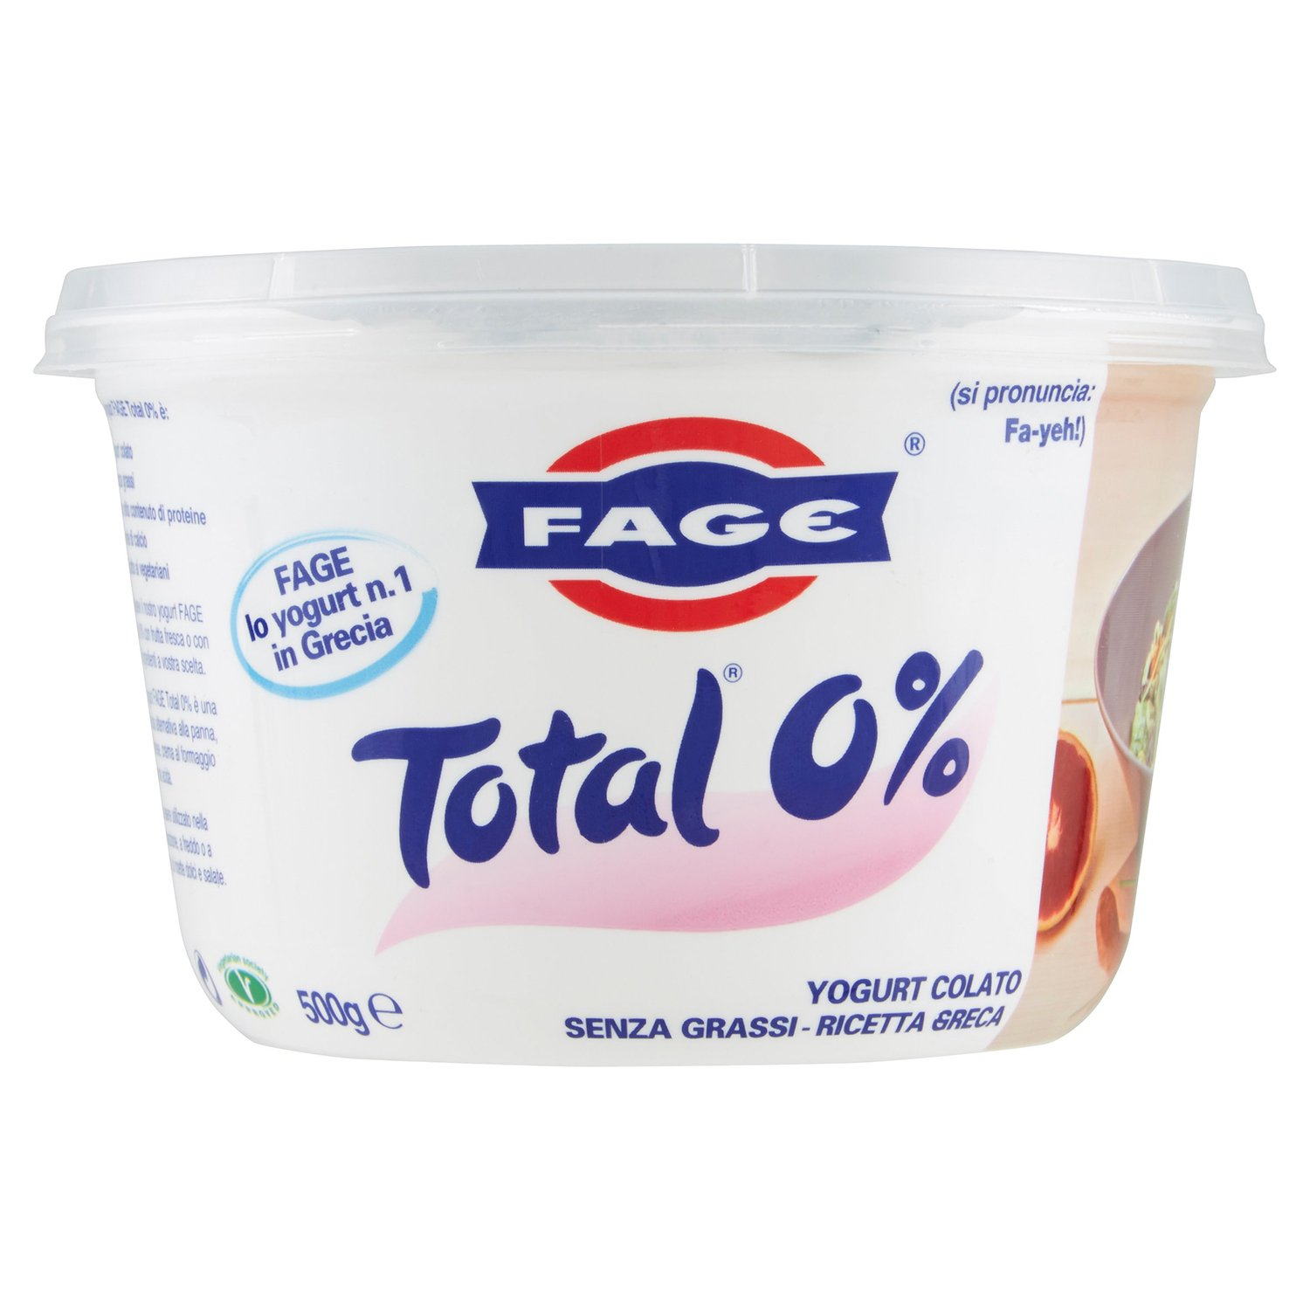

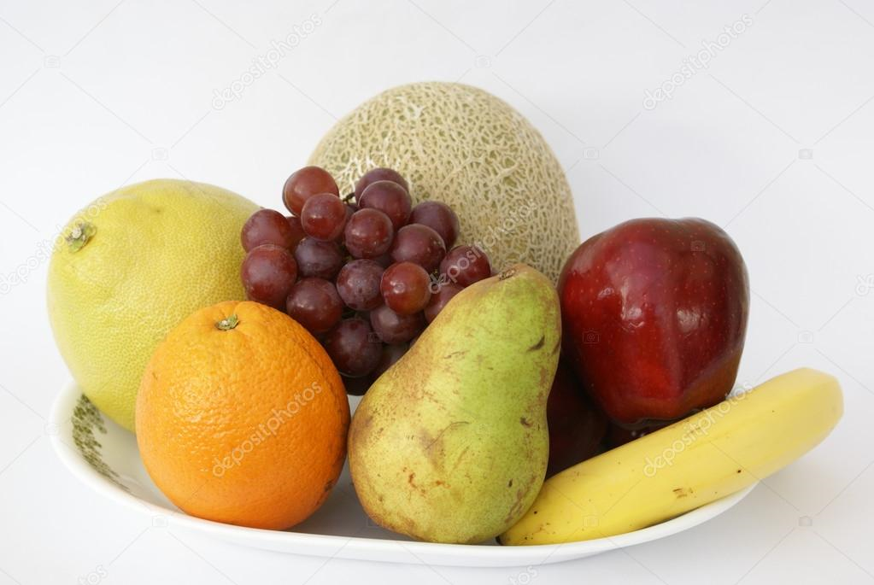
What foods are good for our teeth?
Fiber rich fruits help to keep your teeth and gums clean
Calcium in dairy products help put minerals back in your teeth and rebuild enamel
Also green or black teas help to reduce and fight against plaque

Slide 6
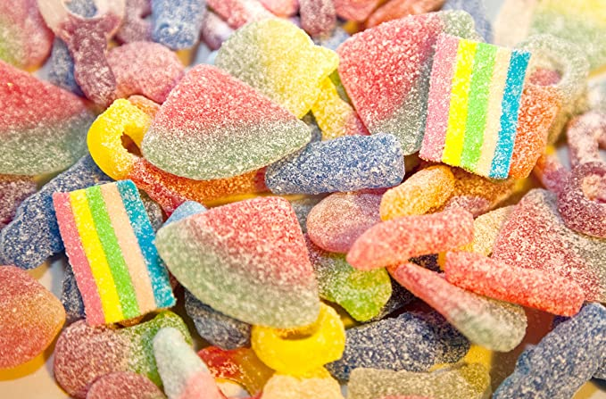
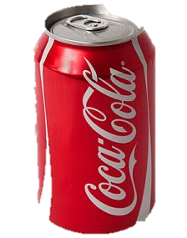
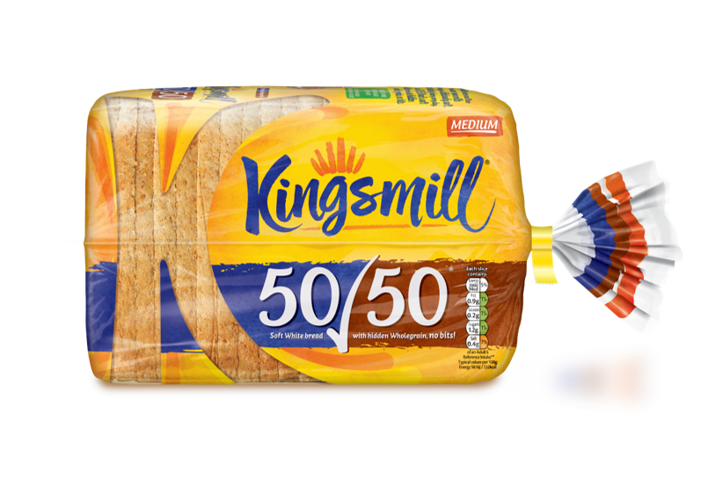
What foods are bad for our teeth?
Soft breads and crisps get stuck in your mouth and trapped between your teeth
Sweets and fizzy drinks contain lots of sugar which can create cavities
If you eat sweets go for the ones which clear your mouth quickly

Slide 7
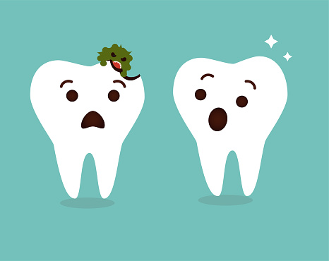
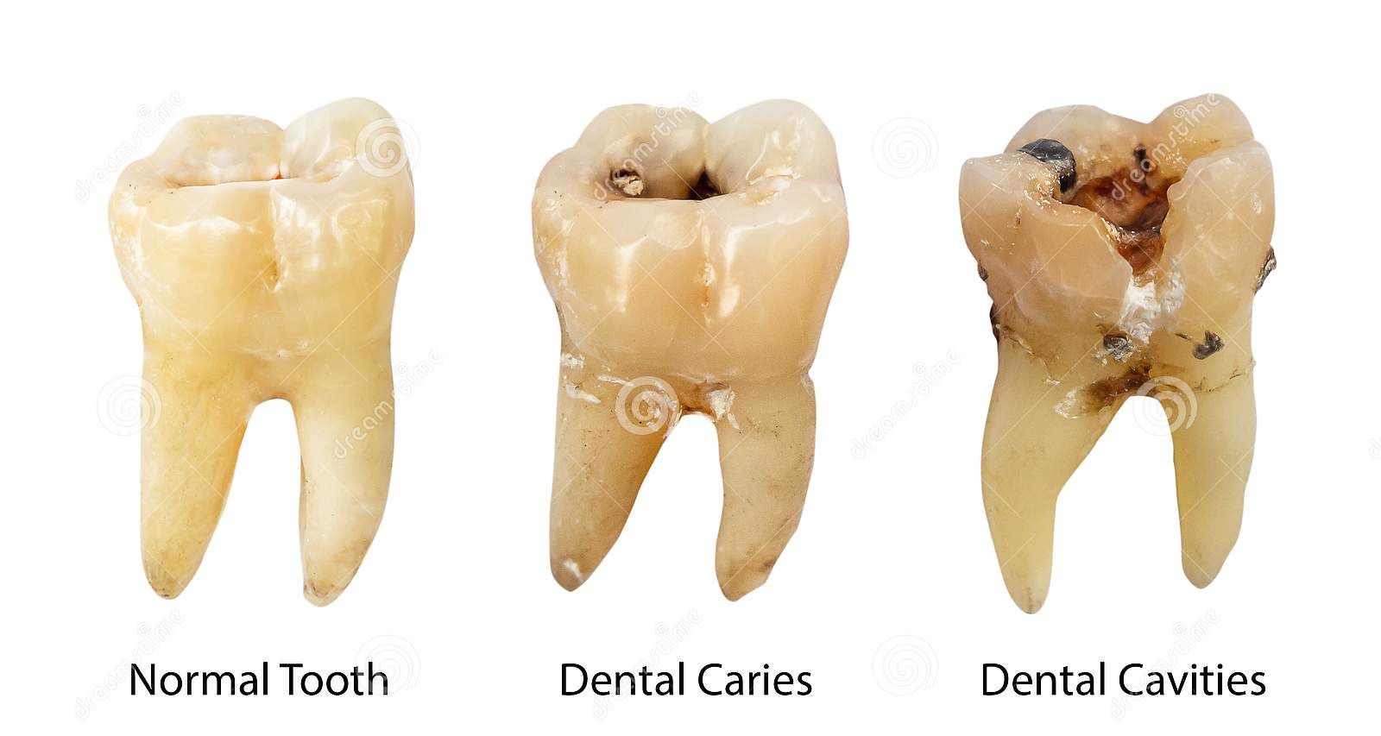
Tooth decay
How are cavities caused?
Bacteria causes a build up of plaque.
Plaque acid attacks the tooth.
The tooth eventually rots away.

Slide 8
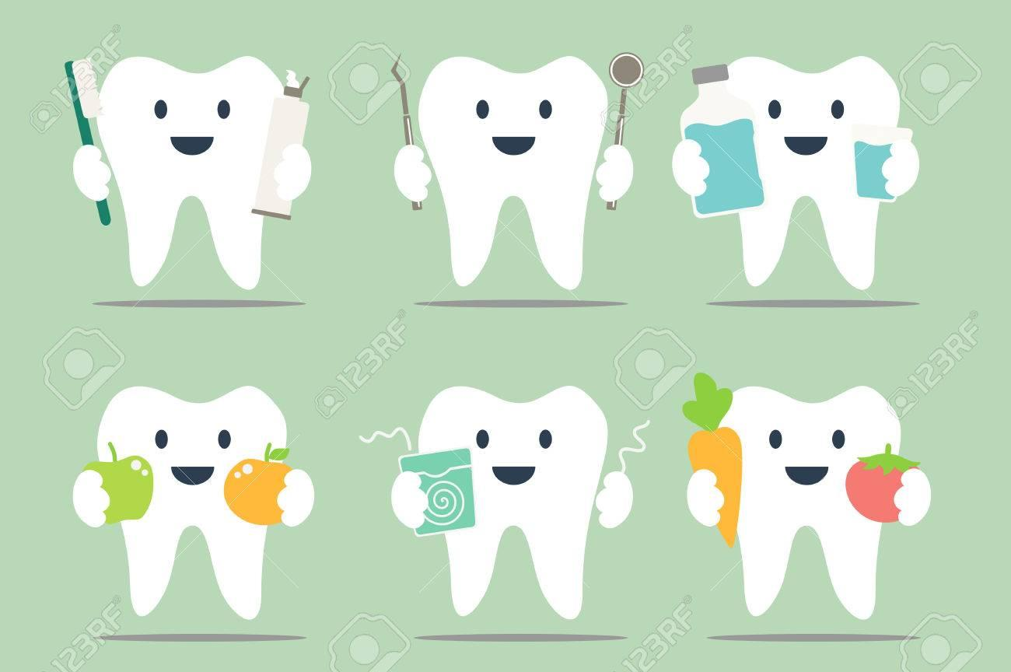
So what do I do to keep my teeth healthy?
Brush regularly
Visit the dentist regularly
Floss
Look after your gums
Eat sensibly

Slide 9
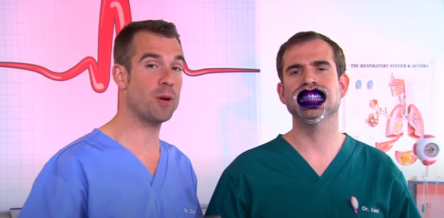
Click on the image below to play the clip!

