Slide 1

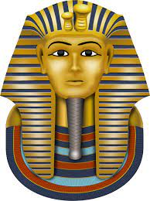
Tutankhamun!
Many years ago, in the land of the pharaohs,
A young boy lived, not yet fully grown.
Many years ago, egypt needed a ruler,
And tutankhamun ascended the throne.
Tutankhamun, the nine-year-old king,
Tutankhamun, what will the future bring?

Slide 2
Many years ago in the land of the Pharaohs, the young king said:
‘Who will be my Queen?’
Many years ago, he chose Ankhesenamun,
The bride to be was only thirteen!
Tutankhamun, the nine-year-old king,
Tutankhamun, what will the future bring?

Slide 3
Now, for ten years he reigned over Egypt,
But the boy-king was frail, and he died.
He was buried, along with his treasure.
More than three thousand years passed,
The tomb was forgotten,
With the secrets of the Pharaoh inside ...

Slide 4
In nineteen-twenty-two, Carter made a discov’ry:
King Tut’s tomb, buried in the sand.
Suddenly the world knew his face and his name:
The most famous Pharaoh in all of the land!
Tutankhamun, the nine-year-old king,
Tutankhamun, what will the future bring?
Tutankhamun, the nine-year-old king,
Tutankhamun, what will the future bring?

