Slide 1
Egyptian Art
What are the hieroglyphics for?

Slide 2
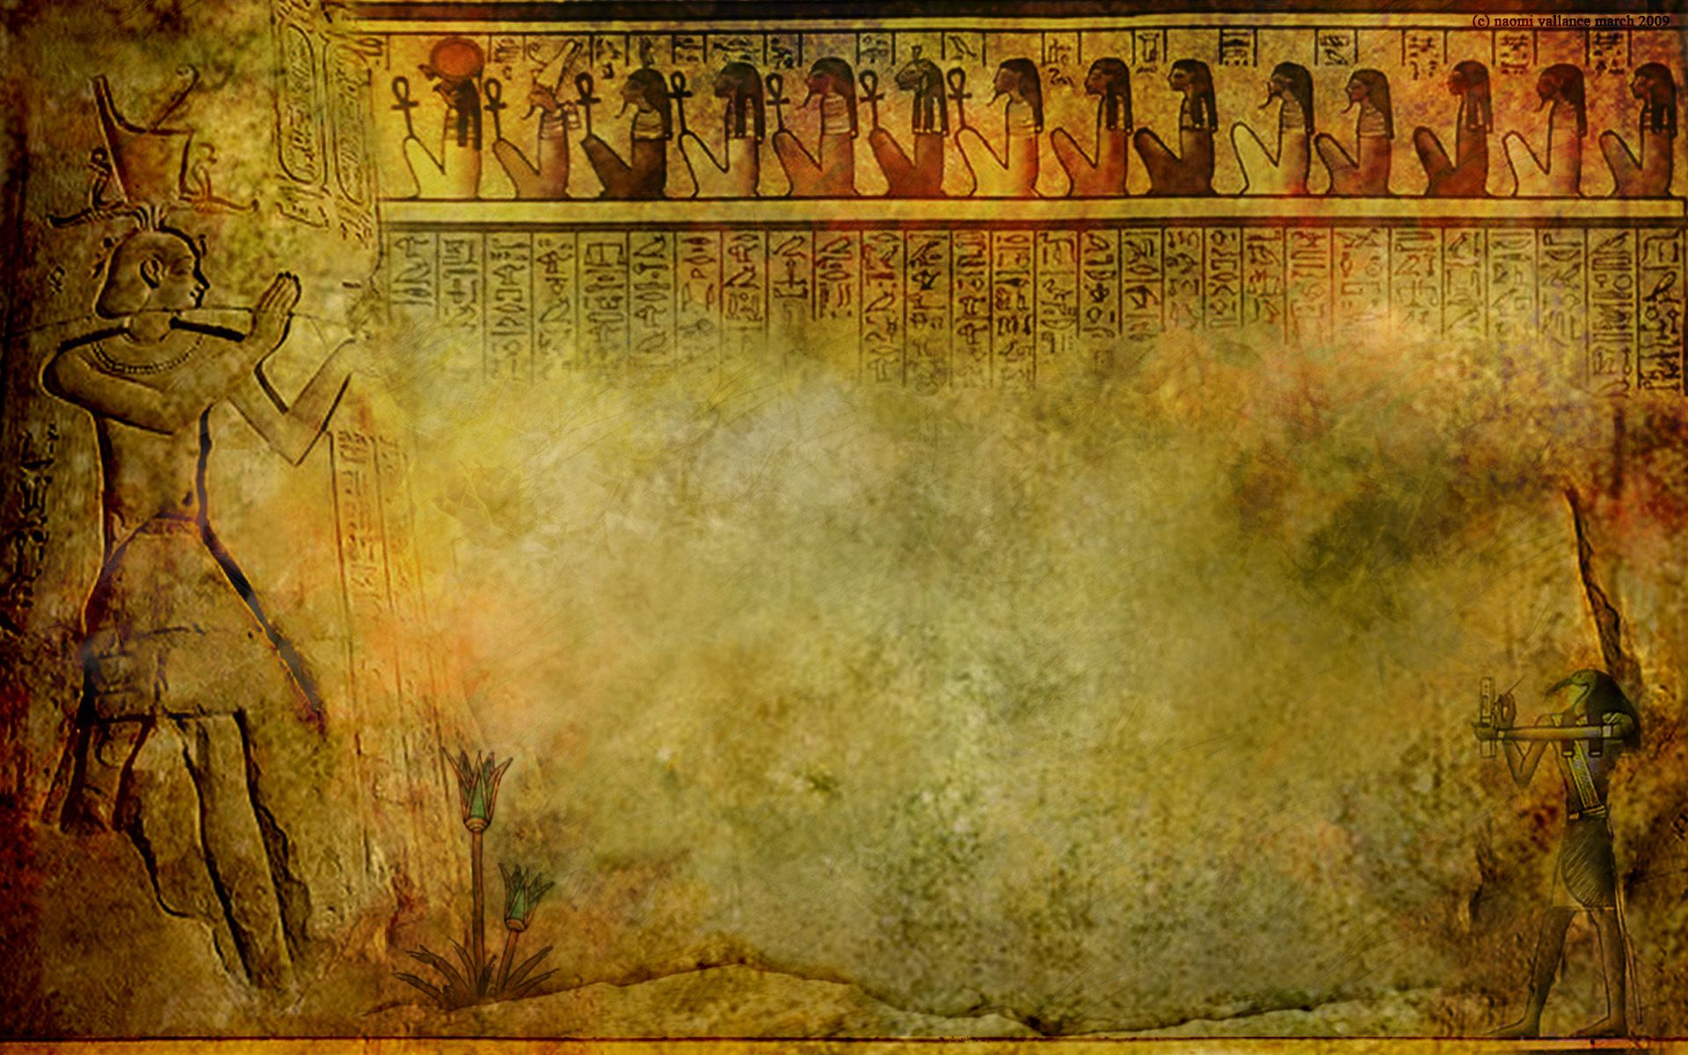
Although hieroglyphics are Egyptian the word hieroglyphics is Greek. “Hiero” means “holy” and “glyphics” means “marks or writing” - so the word means “holy writings”.
The Egyptians believed there was great power in a name. If someone’s name was remembered then he or she would survive in the afterlife. That’s why pharaohs’ names were written in hieroglyphics in their tombs.

Slide 3
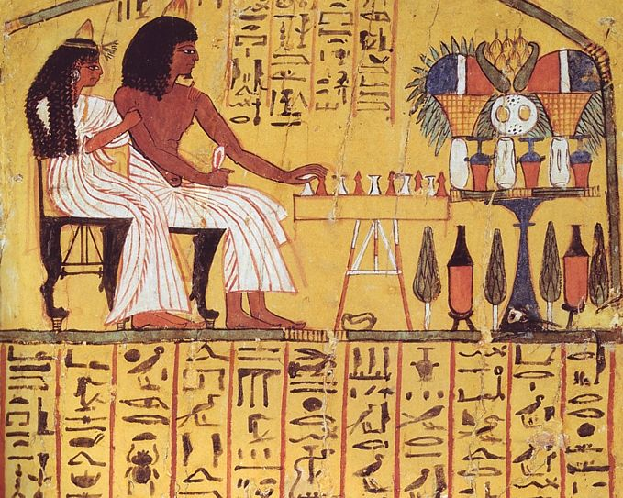
Look again at the art work and focus this time on where the hieroglyphics are in the painting.

Slide 4
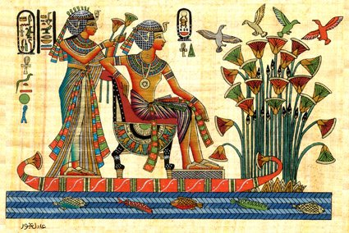

Slide 5
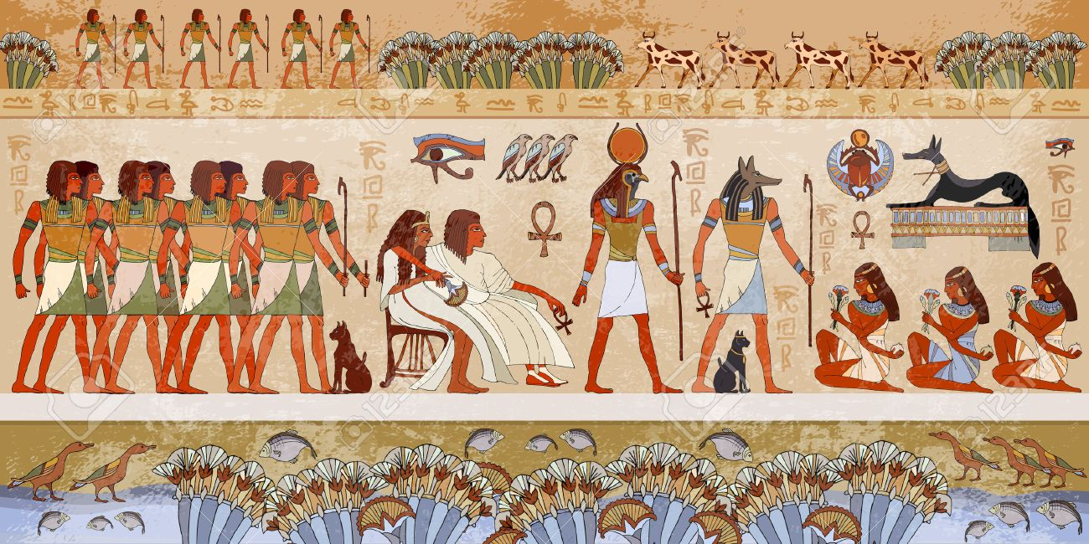

Slide 6
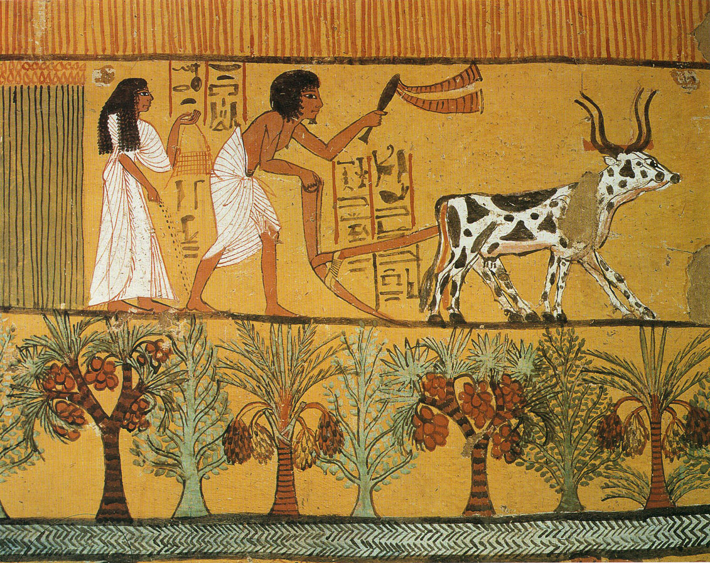

Slide 7
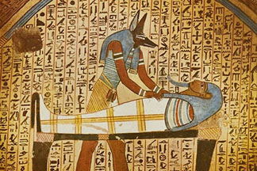

Slide 8


