Slide 1
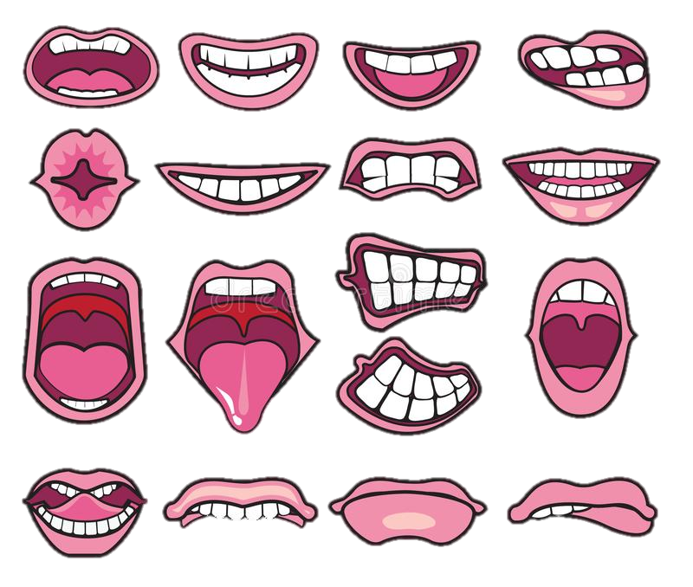
WALT: Identify different types of teeth and their jobs

Slide 2
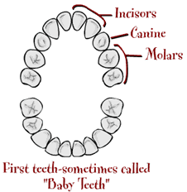
There are four different types of teeth
Incisors
Canines
Pre-molar
Molar
Teeth are made from a hard substance called enamel.

Slide 3
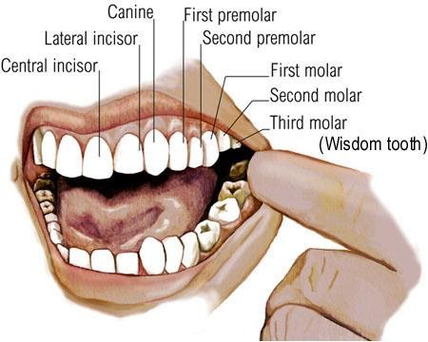

Slide 4

The Jobs of our Teeth
Incisors
I remember this like ‘scissors’ as they cut into the food.
Canines
Canines tear food, think of the word canine it resembles a dog.
Pre-molars
The role of the pre-molar is to rip and crush food, they have a flat biting surface.
Molars
The molars are located right at the back of the mouth and are used for chewing food, ready for swallowing.

Slide 5
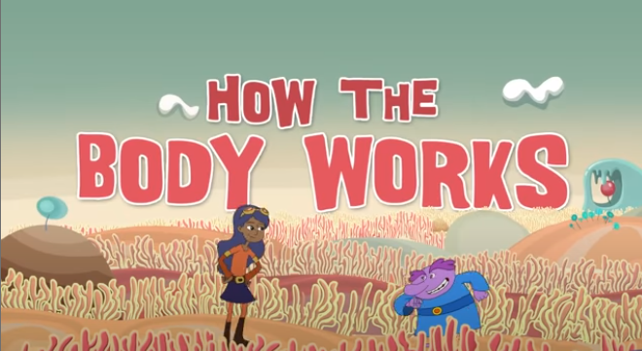
Click on the picture to play the clip!

Slide 6
What do different teeth do?
Match the tooth to its job.
Incisors
Chew
Canines
Tear
Pre-molar
Rip
Molar
Cut

Slide 7
What do different teeth do?
Match the tooth to its job.
Incisors
Chew
Canines
Tear
Pre-molar
Rip
Molar
Cut

Slide 8

Your task:
Is to label the types of teeth in the human mouth.
You can either…
Print off the worksheet (linked in the menu of activities) and colour in the different teeth using the key provided.
Draw your own picture of the mouth and label the different types of teeth.
Then, write a little bit about each of the different types of teeth and what they are used for.

