Slide 1
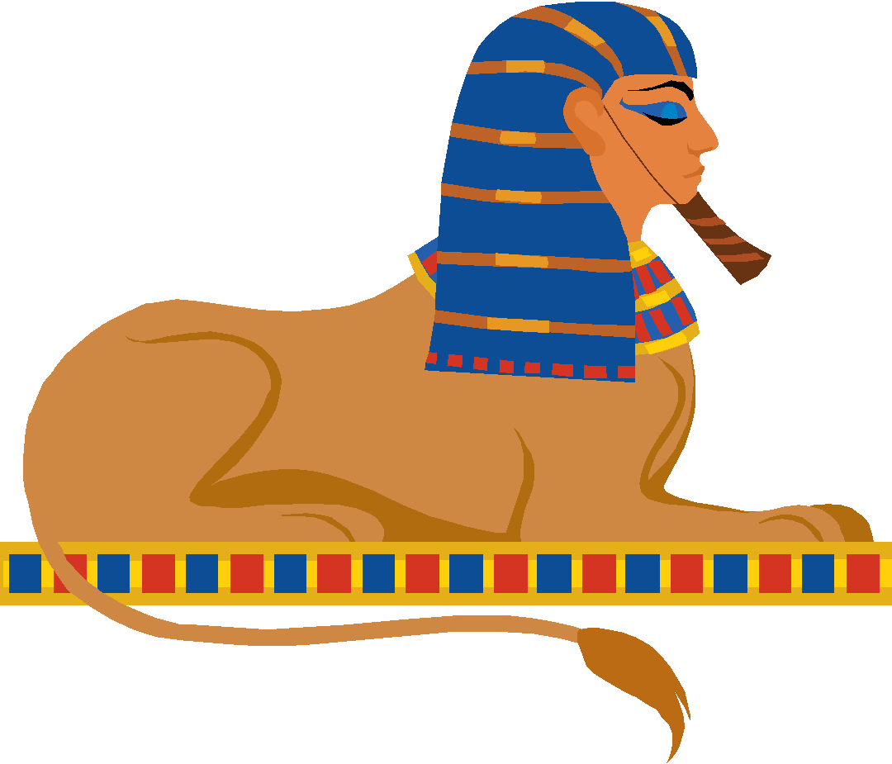
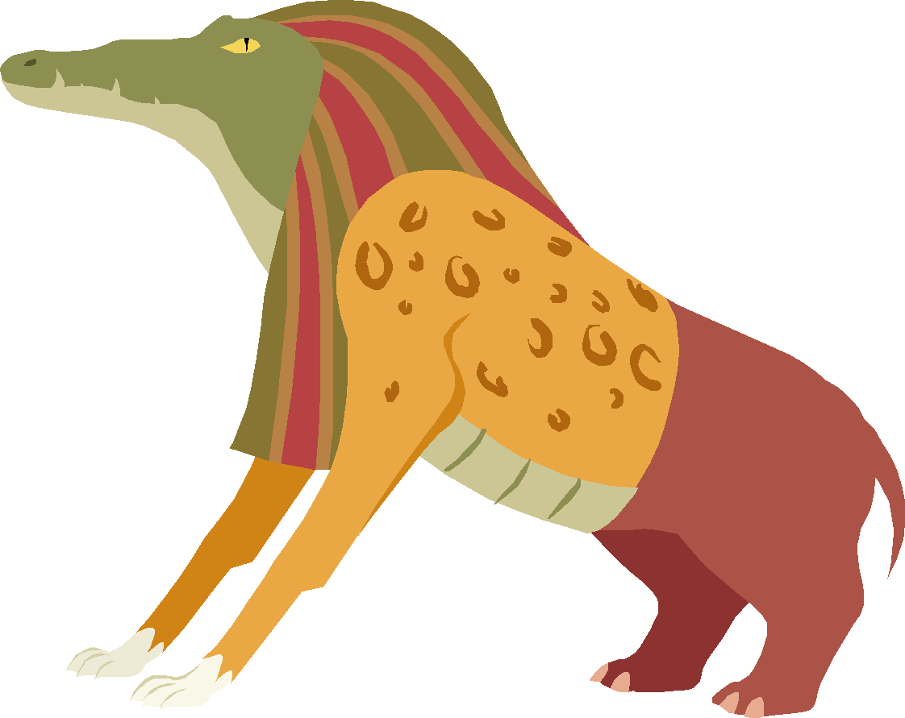
The Weighing of the Heart Ceremony
The Afterlife

Slide 2
People in most ancient civilizations were afraid of their Gods.
This was not true in Ancient Egypt. The Egyptians loved their Gods. They had little fear and great wonder.

Slide 3
There was one exception, though - the God Ammut.
Almost everyone in ancient Egypt was afraid of Ammut! Ammut was the Devourer.
The ancient Egyptians believed if you did something bad, your heart would be heavy, and the God Ammut might suddenly appear and eat you up!

Slide 4
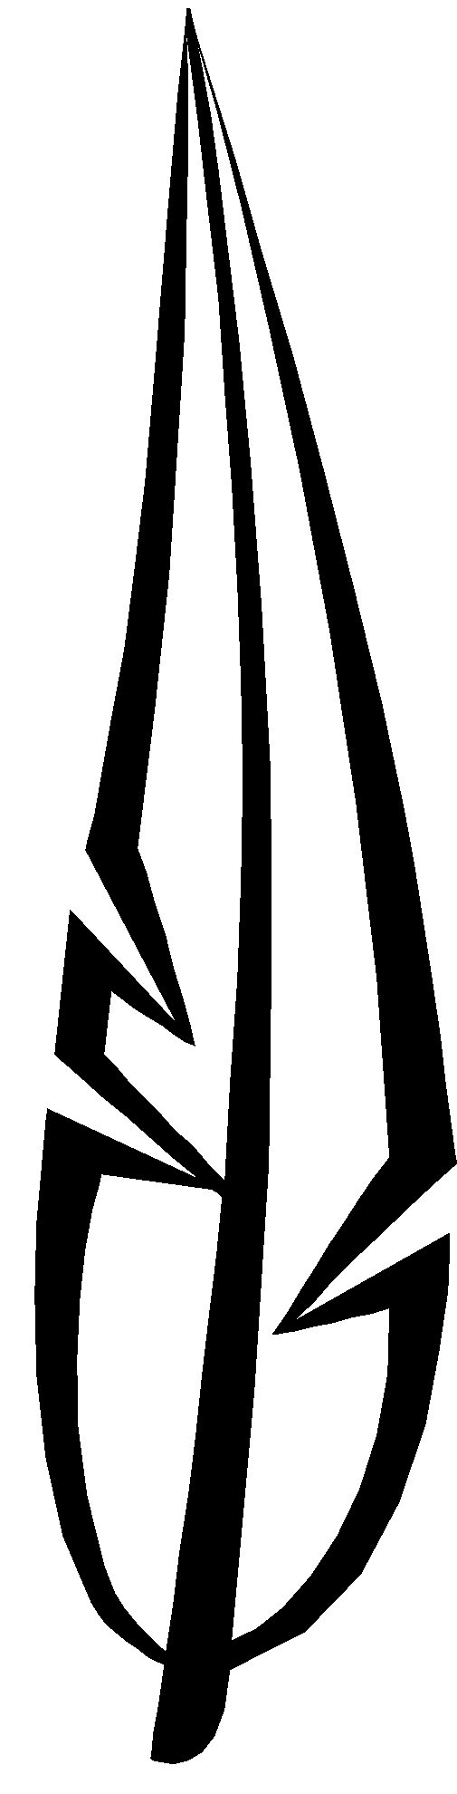
The God Ammut had a big part in the weighing of the heart ceremony.
When you died, the ancient Egyptians believed you travelled to an afterlife, a heavenly place where you spent eternity.
You had to earn your way. To enter your afterlife, you had to have a light heart. Light hearts were earned from a lifetime of doing good deeds.

Slide 5
After you died, the ancient Egyptians believed your heart had to be weighed.
It had to be lighter than a feather. To find out if your heart qualified for the trip to the afterlife, your spirit had to enter the Hall of Maat.

Slide 6
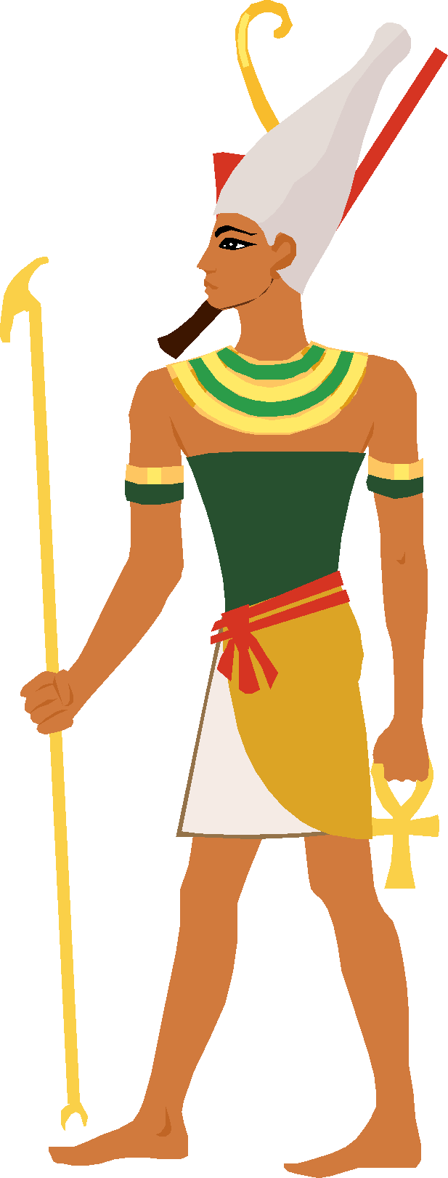
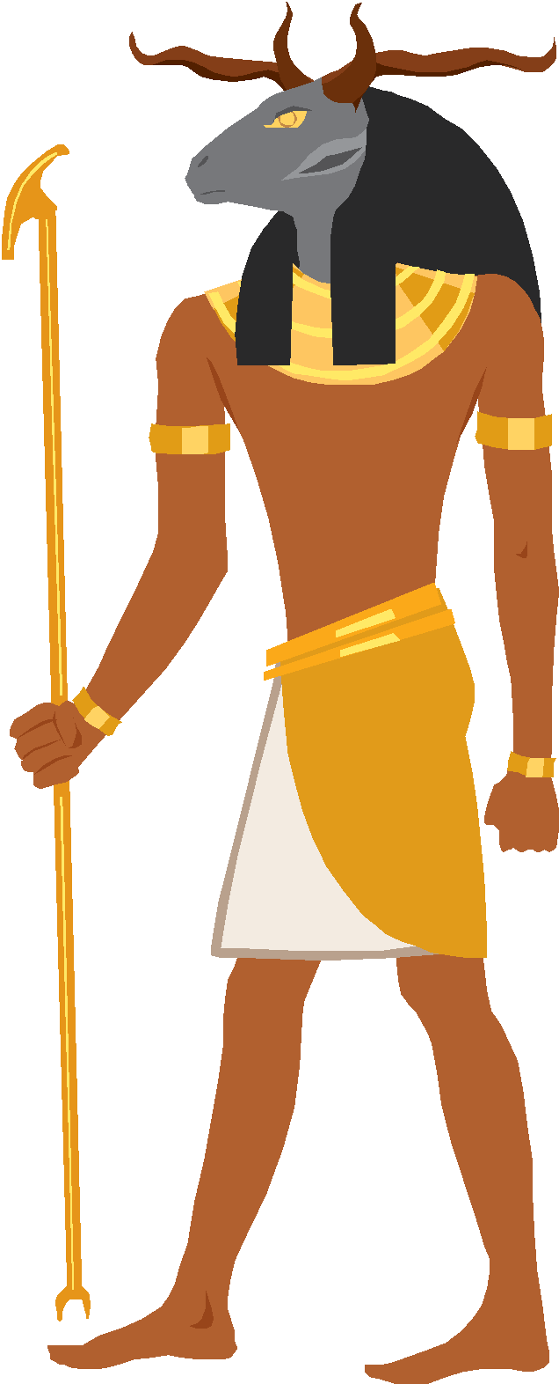
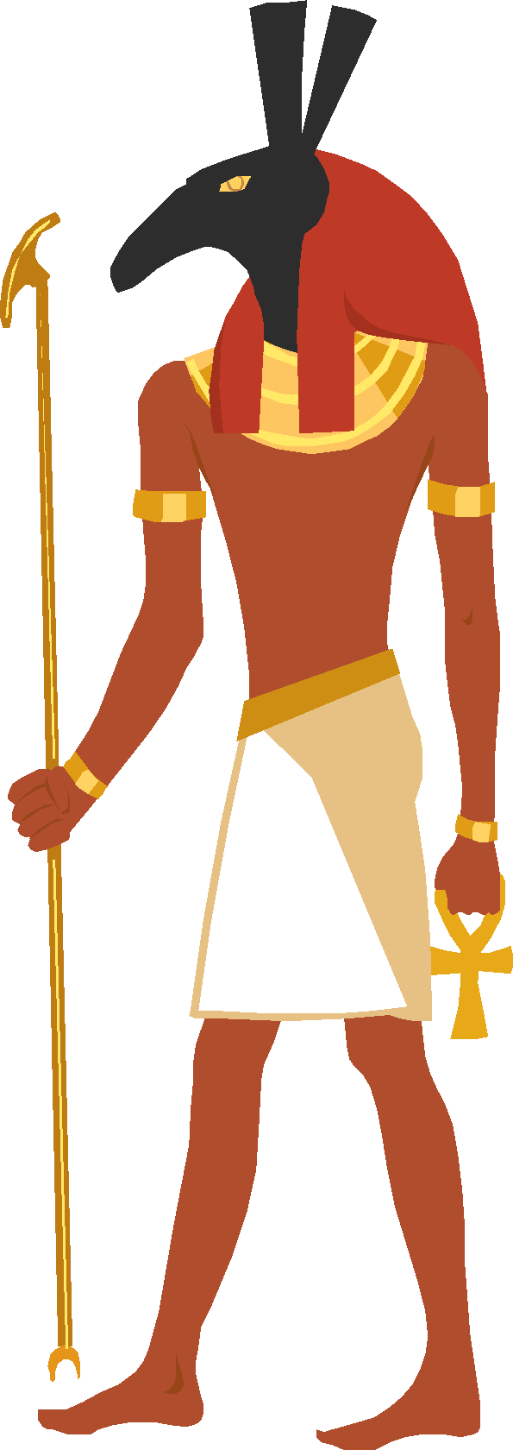
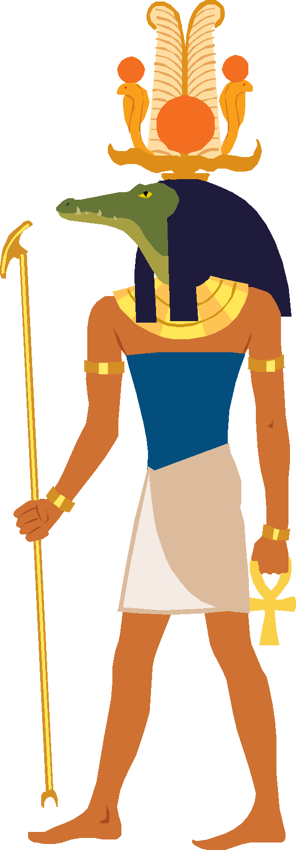
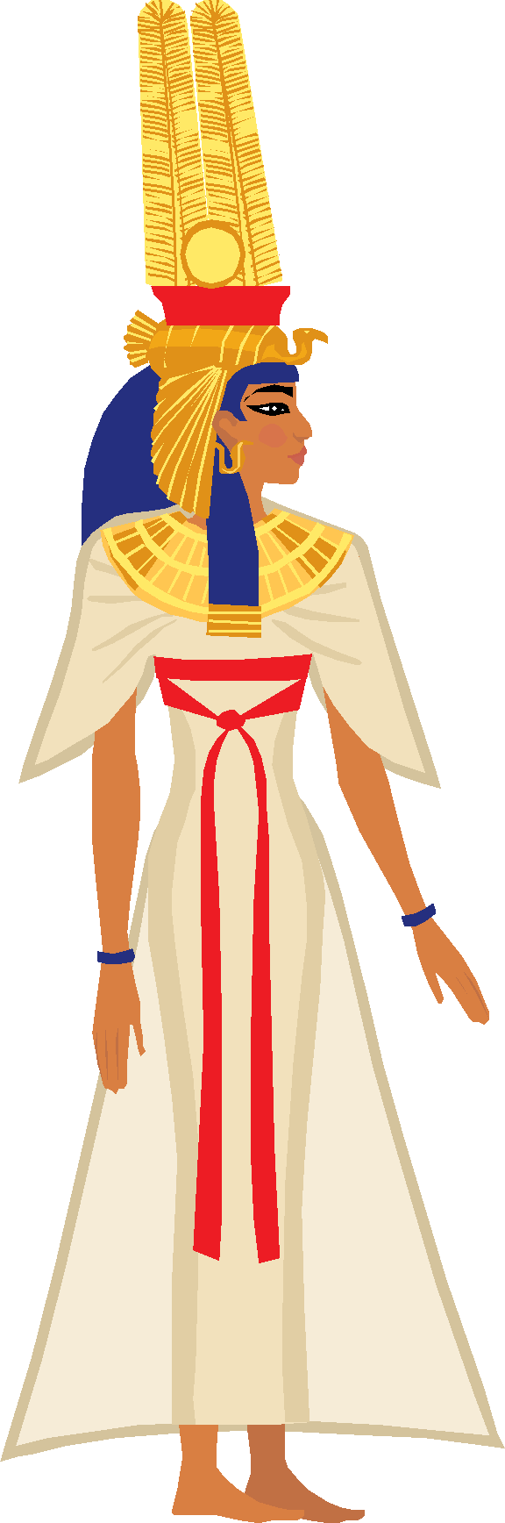
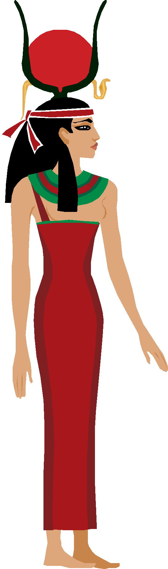
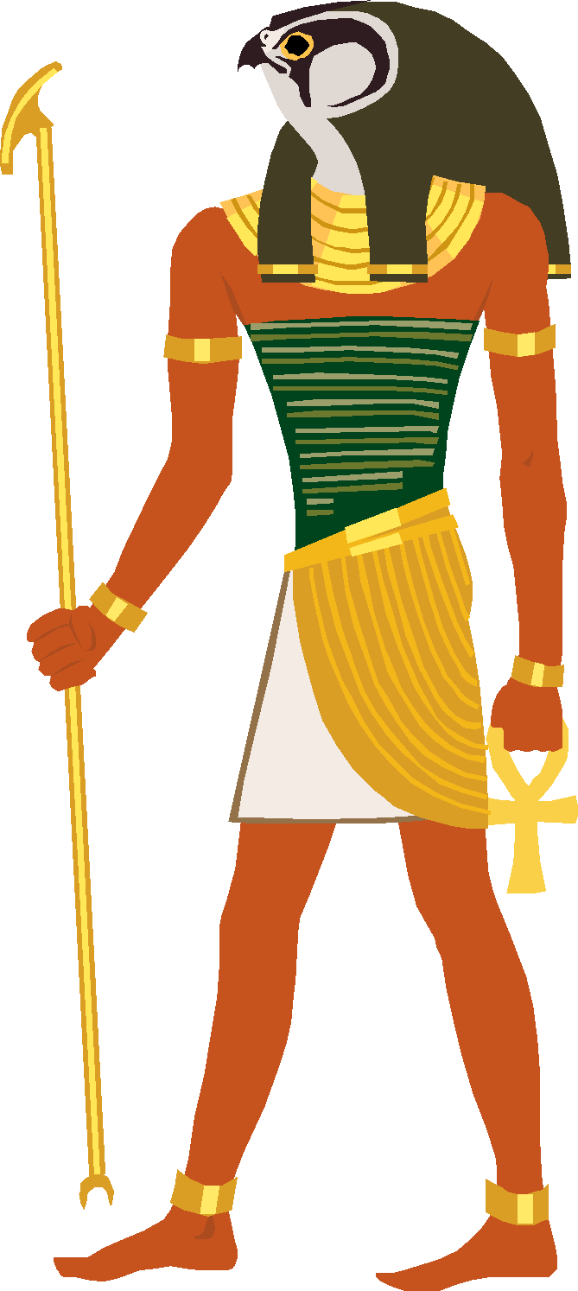
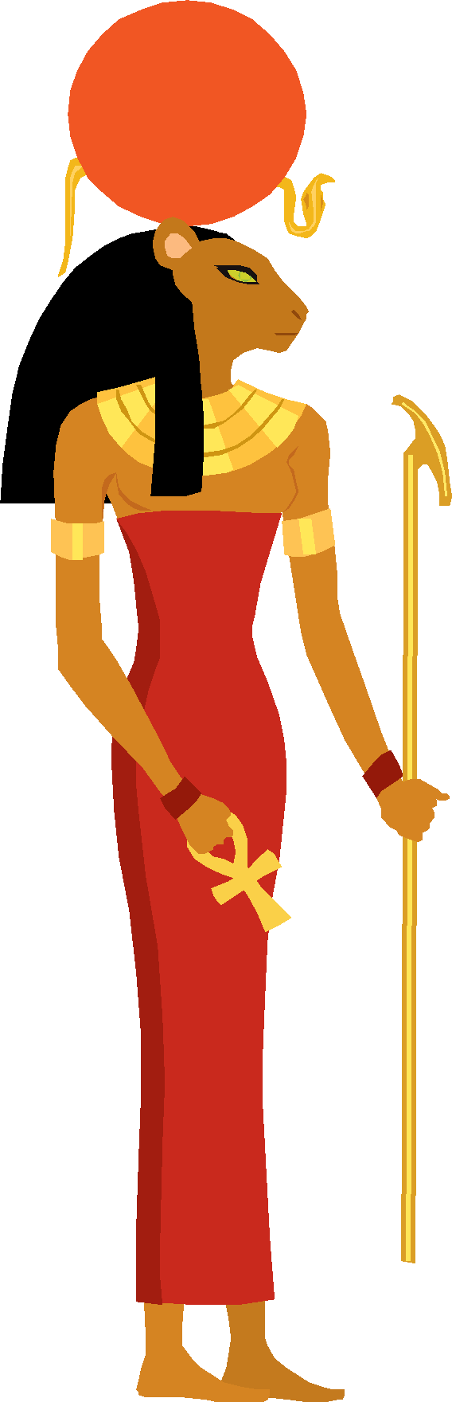
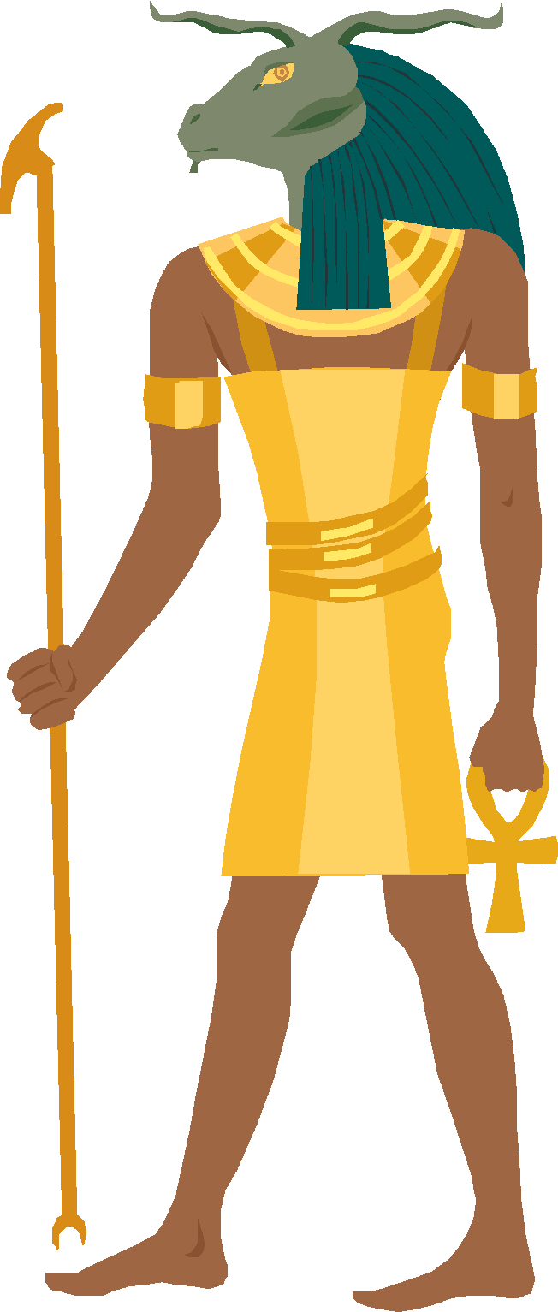
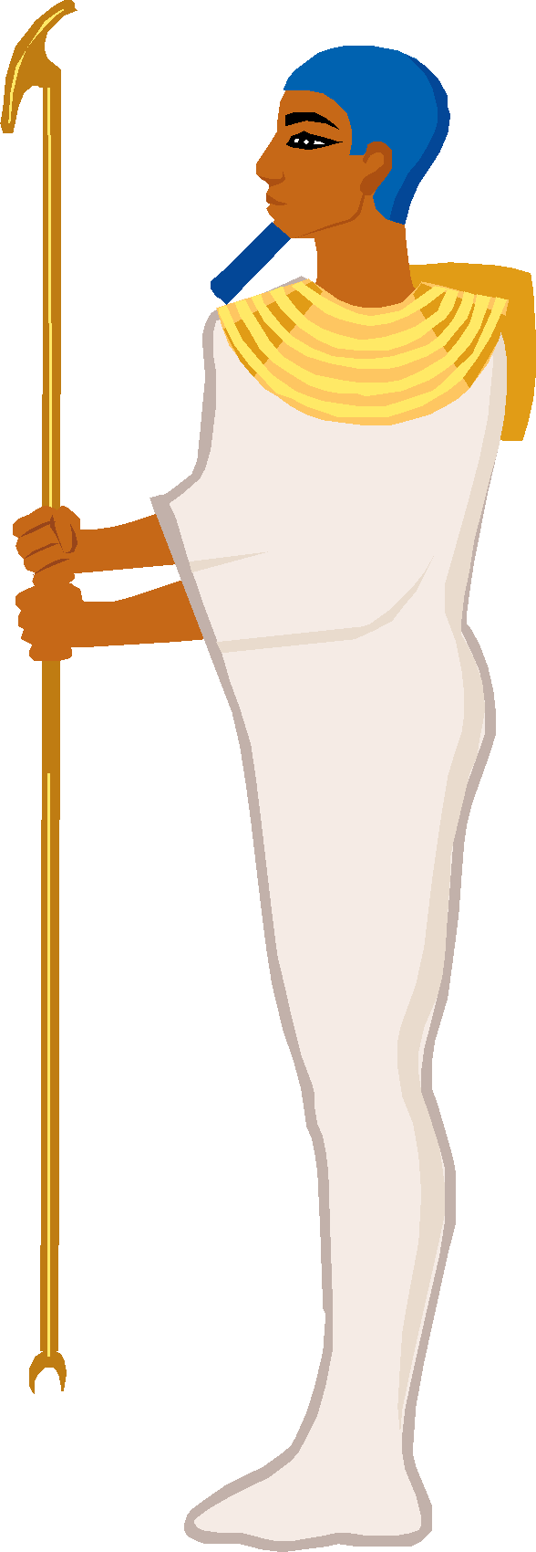
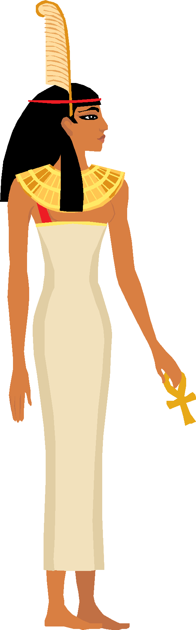
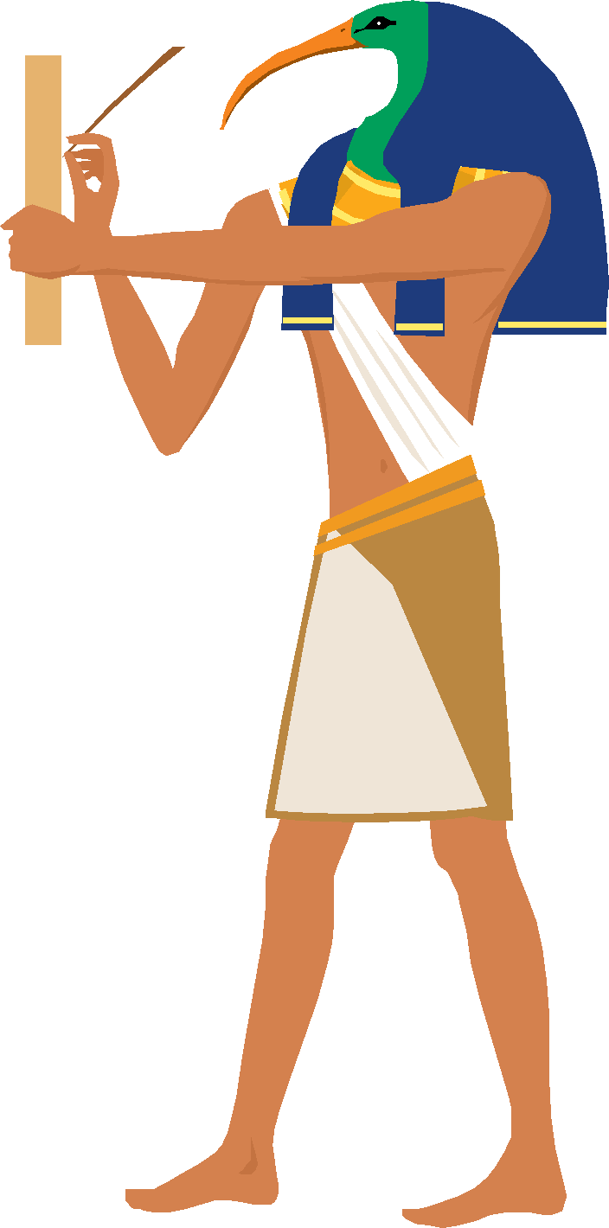
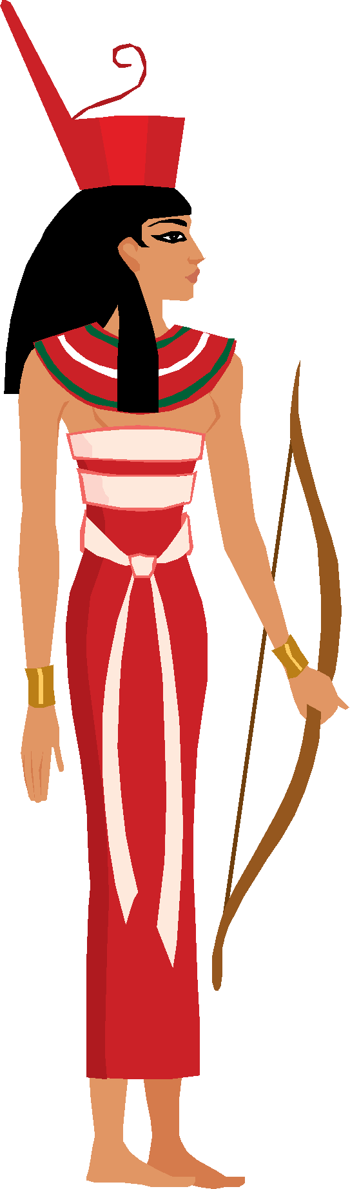
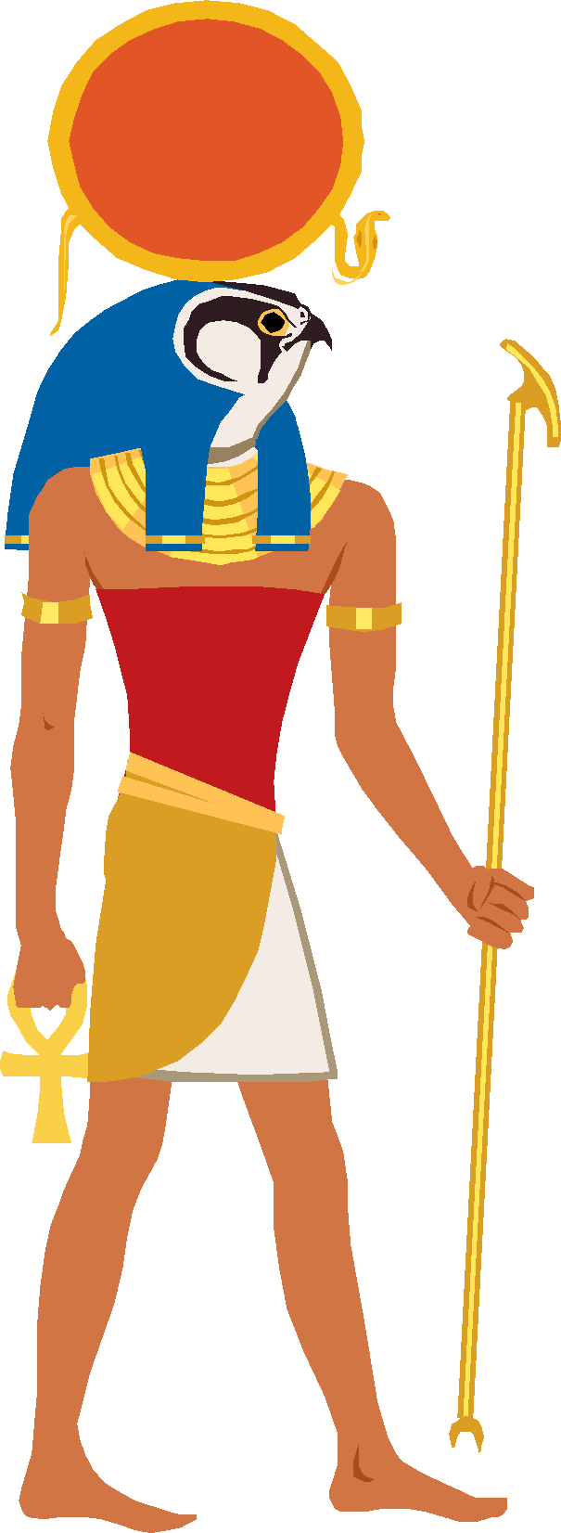
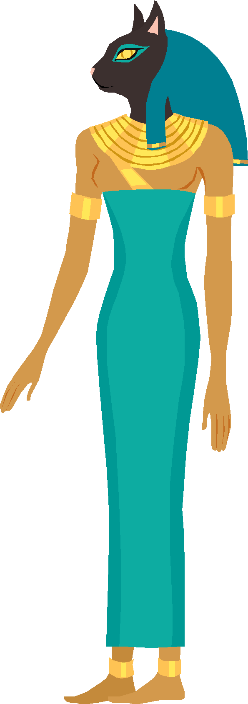
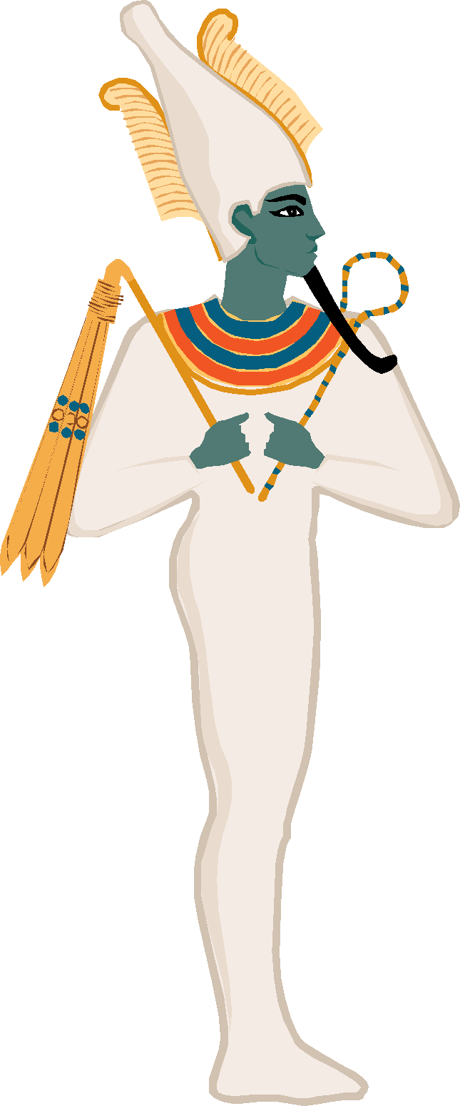
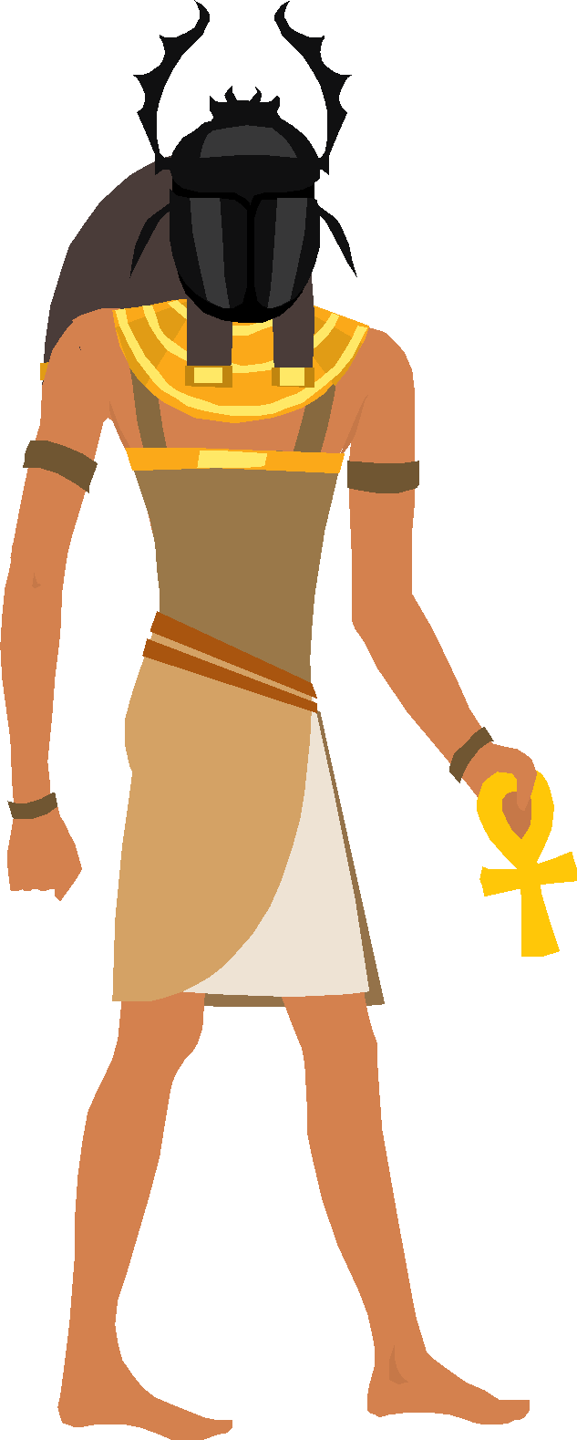
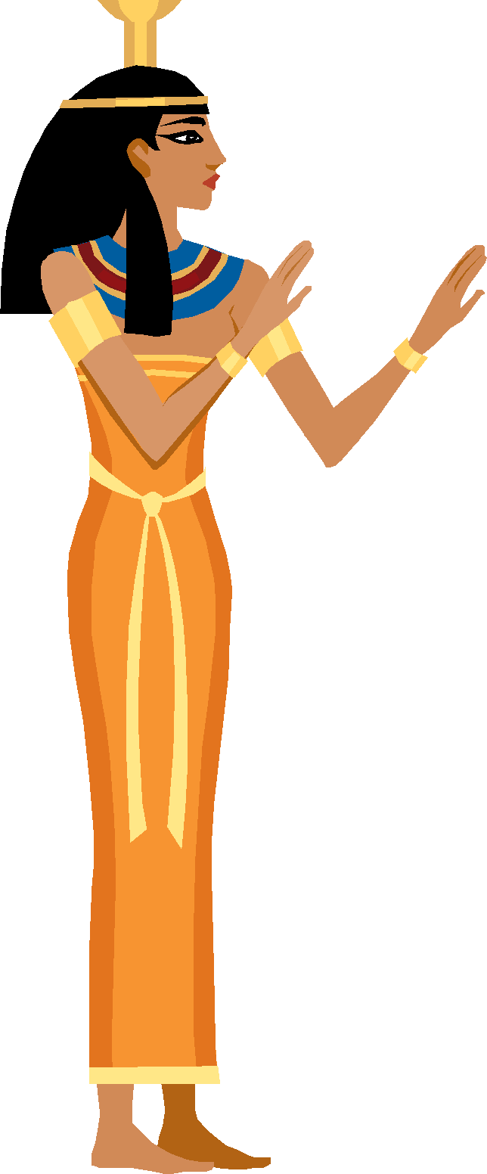
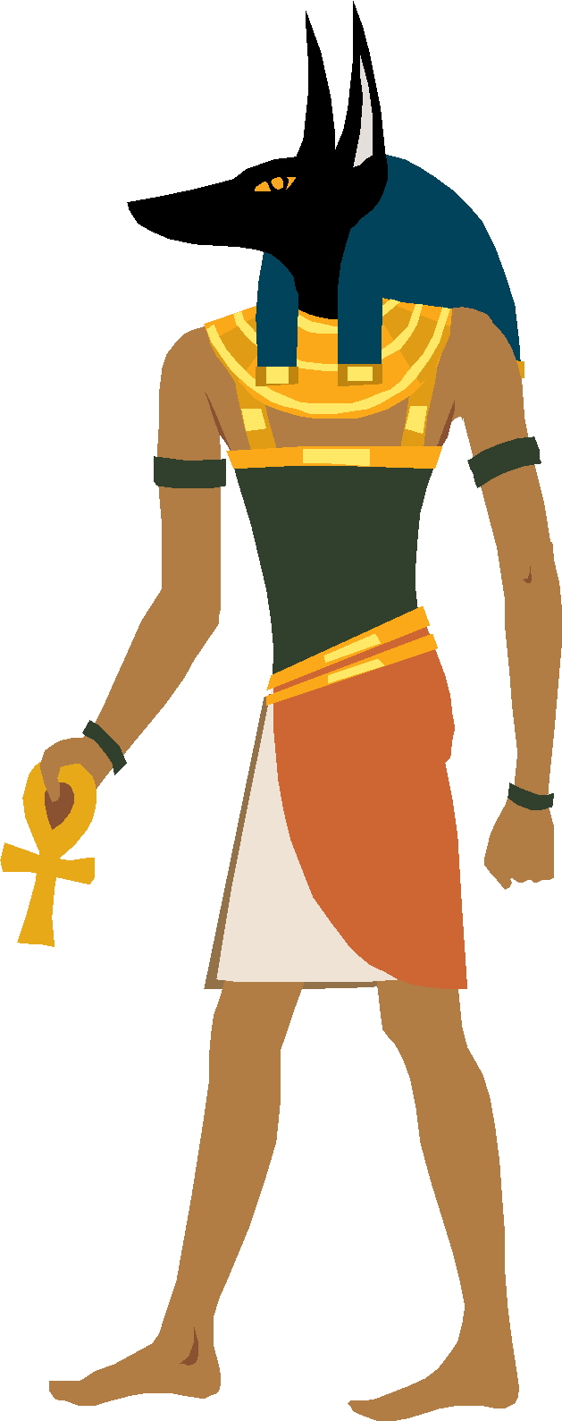
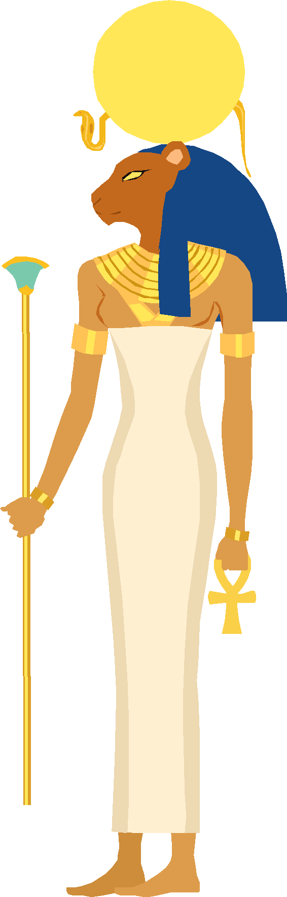
First you had to plead your innocence to the Gods and your fellow men

Slide 7
Then the God Anubis would lead you into the Hall of Maat and weighed your heart

Slide 8
The God Thoth recorded the findings.
(In ancient Egypt, everything was recorded and written down.)

Slide 9
If your heart was light, you were considered to be pure and free from sin. This meant you had passed the test and entered your afterlife. Lead by Horus to Osiris.

Slide 10
BUT, if your heart was heavy because your deeds were dreadful, the God Ammut would suddenly appear ... and eat you up!

