Slide 1
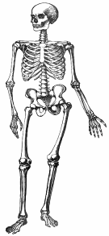
The Skeleton
WALT: understand the functions of the skeleton
Notes:
‹#›

Slide 2
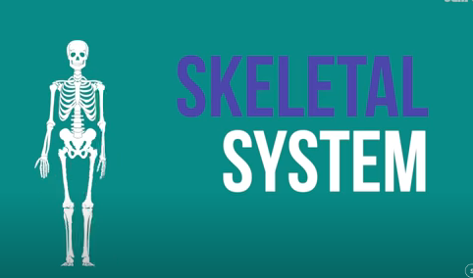
The skeleton song!

Slide 3
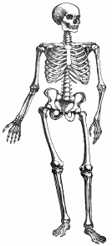
Why do we have a Skeleton?
All humans have a skeleton. Why do you think we have a
skeleton?
What would people look like without a skeleton?
What wouldn’t we be able to do without a skeleton?
What are our skeletons made from?

Slide 4

Major bones in the human body
Skull
scapula
sternum
Ribs
Humerus
Spine
Pelvis
Femur
hands
Tibia and Fibula
feet
Notes:
‹#›

Slide 5

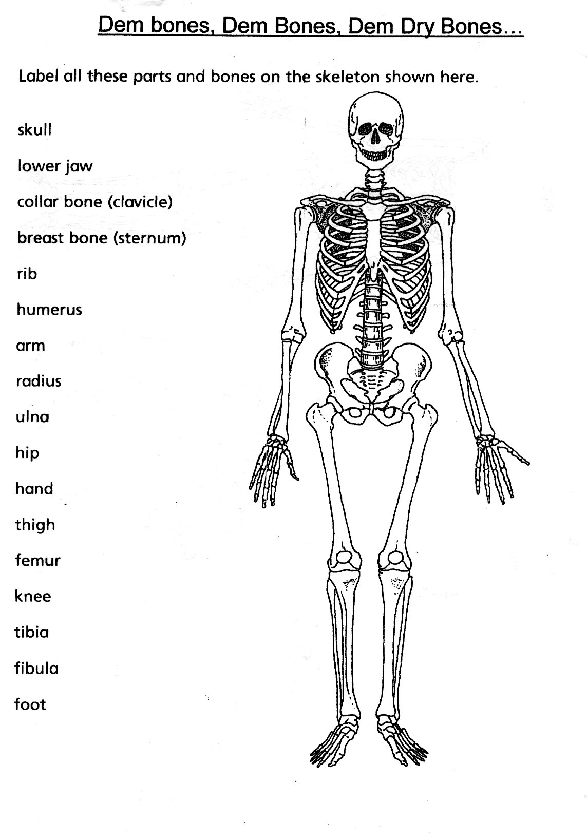

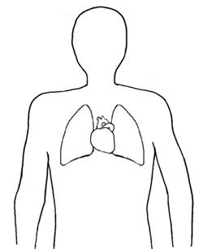
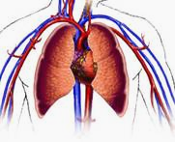
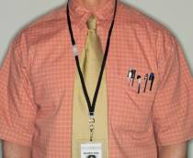
The Skeleton Protects
My brain is protected by my skull.
My heart and lungs are protected by my rib cage.
Our skeletons protect the main organs of our bodies.

Slide 6

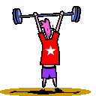

The Skeleton Supports
Our skeleton also supports our bodies and keeps them upright. Our skeletons help us to lift and move things.
Without the support of our skeletons our bodies would fall to the floor and look like a flat football!
Notes:
‹#›

Slide 7

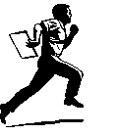
Our Skeleton helps us to move
Our skeletons help us to walk, run and move. Our muscles are attached to our bones with tendons. We can move because these tendons pull our bones backwards and forwards.

