Slide 1
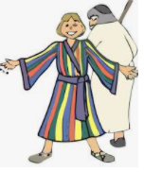
Joseph’s story

Slide 2

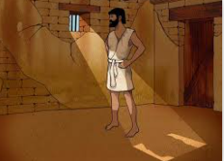

Joseph in prison…
Click to hear
At the end of last week’s clip, Joseph was bought by Potiphar as a slave.
We see that Joseph is clever and helps Potiphar. All goes well until Joseph annoys Potiphar’s wife, who lies and says he attacked her.
Joseph is put in prison, where he interprets the dreams of the Pharaoh’s butler and baker- the butler is then freed and goes back to work for the Pharaoh. When the Pharaoh is having bad dreams, the butler tells him about Joseph who is sent for and Pharaoh makes him an adviser.
Why do you think Joseph is able to interpret dreams ? Who might be helping him, do you think?

Slide 3
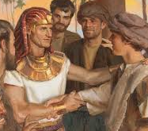
Joseph and his brothers meet….
Click to hear
Joseph is very successful and becomes a powerful man. Meanwhile in Canaan there is a famine and Jacob (Joseph’s father) sends all of his sons, except Benjamin (who is his youngest son and has comforted him since Joseph ‘died’) to Egypt to ask for help.
The brothers are sent to see Joseph but don’t recognise him – however, he recognises them. He decides to test them to see if they are still as bad as they had been, so he accuses them of being spies and throws them in prison.

Slide 4
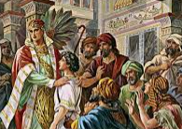
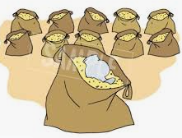
Bring me Benjamin…
Click to hear
After three days Joseph sets all of his brothers except one, free - he sends the others home with wheat but says they must return with Benjamin (their youngest brother).
When they come back Joseph hides a silver cup in Benjamin’s sack and when the brothers leave to go home, Joseph orders his servants to search them. The cup is then found. Joseph says whoever has stolen it must stay and be his slave.
Why do you think Joseph did this? What do you think the brothers will do? What would you do if you were one of the brothers?

Slide 5
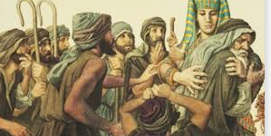
Joseph and the big reveal…
Click to hear
The brothers know how upset Jacob will be and offer to take Benjamin’s place. Now Joseph knows they have changed and reveals who he is.
Afterwards, he tells his brothers to go and get the rest of their Hebrew family and come to live in Egypt.

Slide 6
Many years later…
Click to hear
All goes well for the family for many years, but after Joseph and the Pharaoh die, a new Pharaoh becomes worried that there are too many Hebrews living in Egypt and they will become more powerful than him and take over.
How can the Pharaoh solve the problem? What would you do in his place?

Slide 7
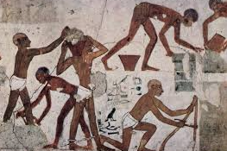
The answer…
Click to hear
The Pharaoh decided to make the Hebrews slaves, so they had no power and would be weakened by all the hard work. But the Hebrews believed they were special to God and were his chosen people – the ones he would look after and care for above all others.

Slide 8
Your Task today…
Click to hear
Now you have shared the story of Joseph, what questions would you like to ask to:
Joseph
Jacob
The new pharaoh
Think of different ways of starting your questions. You could start them with:
Why did you….?
How did you feel when ….?
Do you think ……?
Write your questions down and email them in to the Year3/4 Team.
When you have written your questions move on to the next slide.

Slide 9
Now you can watch the clip that is lnked shown below…
Click to hear
Testament - Bible In Animation - Joseph [2/3]
Will you add some more questions or will you now change some of your questions?

