Slide 1
Ancient Egyptian Wall Paintings

Slide 2
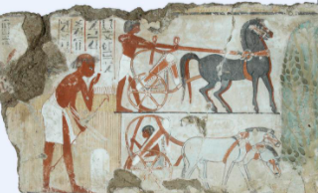
We can learn alot about the life and times of the Ancient Egyptians by looking at their tomb paintings.

Slide 3
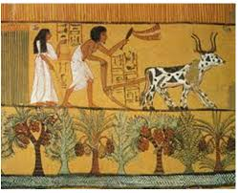
These paintings often depicted (showed) how the Ancient Egyptians lived, how they spent their time and what the surrounding landscape was like.

Slide 4
See if you can decide what is happening in the following paintings and look at the surroundings and background within them.
What can you see there?

Slide 5
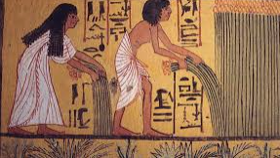
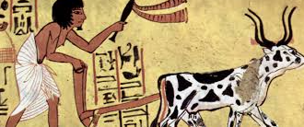
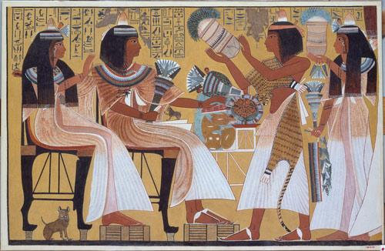
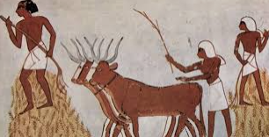

Slide 6
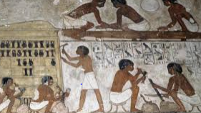
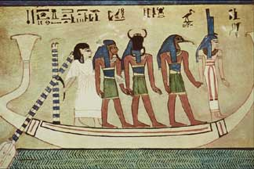
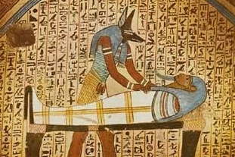

Slide 7
We have already previously drawn an Ancient Egyptian and now we need to think about the surrounding background or landscape and what it might look like.
Your job today is to create a three dimensional background for an Ancient Egyptian painting. You could make a diorama or recreate the scene in your room, using everyday things e.g. jumpers for hills, small boxes for boats, pasta for crops and so on. Be creative (but please ask permission first!)and take a photo, then send it in!
p

Slide 8
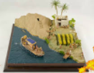
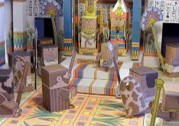
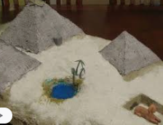
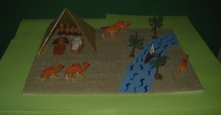
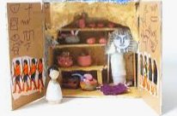
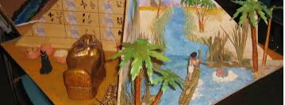
Here are some examples of models and dioramas

