Slide 2
Week 3 - History
Ancient Egyptian Gods and Goddesses. - PART 1
Today we will make a fortune teller to help us to present facts about some of the ancient Egyptian Gods and Goddesses.
First, read through the Powerpoint to meet a selection of the Ancient Egyptian Gods or Goddesses. There was believed to be over 2,000 gods that the Egyptians believed in. There is a funny (if not a little silly hehe) clip HERE taken from Horrible Histories.
Then, use this link HERE to watch an instructional video on how to make a paper fortune teller (Mr Brown made one last week in collective Worship). You might want to use an A3 piece of paper as the bigger the better.

Slide 3
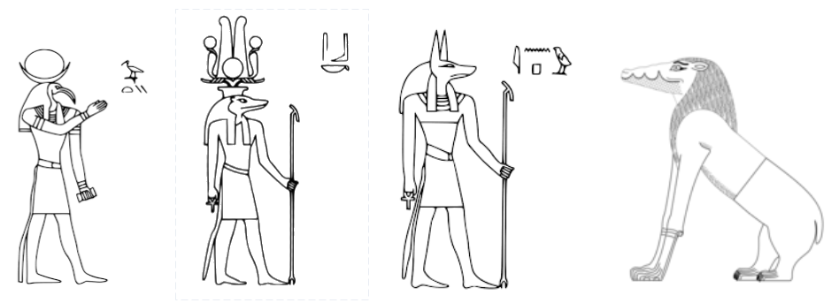
Week 3 - History
Ancient Egyptian Gods and Goddesses - PART 2
Once you have made your fortune teller, you can use these pictures to decorate the outside flaps.

Slide 4
Week 3 - History
Ancient Egyptian Gods and Goddesses - PART 3
After decorating the outside flaps with the colorful pictures, write the names of four of the gods on the inside of the flaps (you will have to write across two flaps (see pictures on next slide).
Remember to make it colourful and well presented even when you are writing the names. You could even use some hieroglyphics.
Under these names, write one or two facts about that god that is named on that flap. Again, think about how you will set your work out and how colourful you will make it. Maybe you could include some Egyptian symbols or pictures.
Then bravo! You are finished. PICTURES ON NEXT SLIDE

Slide 5
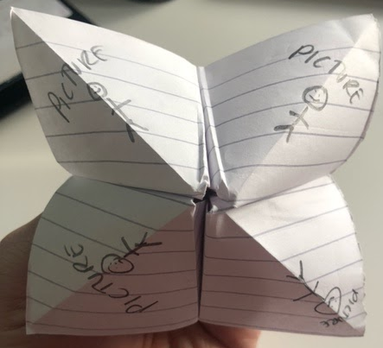
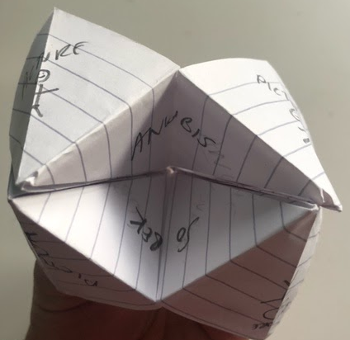
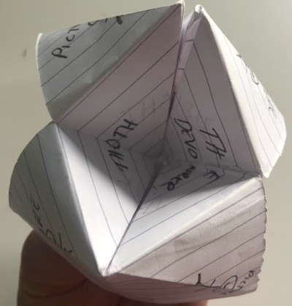
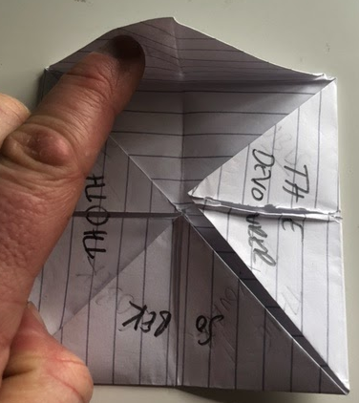
Week 3 - History
Ancient Egyptian Gods and Goddesses - PART 4
Here are some pictures from a quick one that I made. It is not up to the standard of work that you guys produce! hehe
Outer Flaps The Names of the Gods The space for Facts
Now off you go and enjoy making your own!
REMEMBER: You are 10 times the artist I am - Mr B :-)

Slide 6
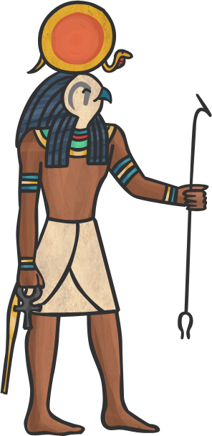
NAME: Ra
GOD OF: the sun
Ra was the most important god to all the Egyptians.
It was believed that he was swallowed by Nut the sky goddess every night and born again in the morning.
The Egyptians also believed that Ra travelled through the underworld at night, where he appeared as a man with the head of a ram!

Slide 7
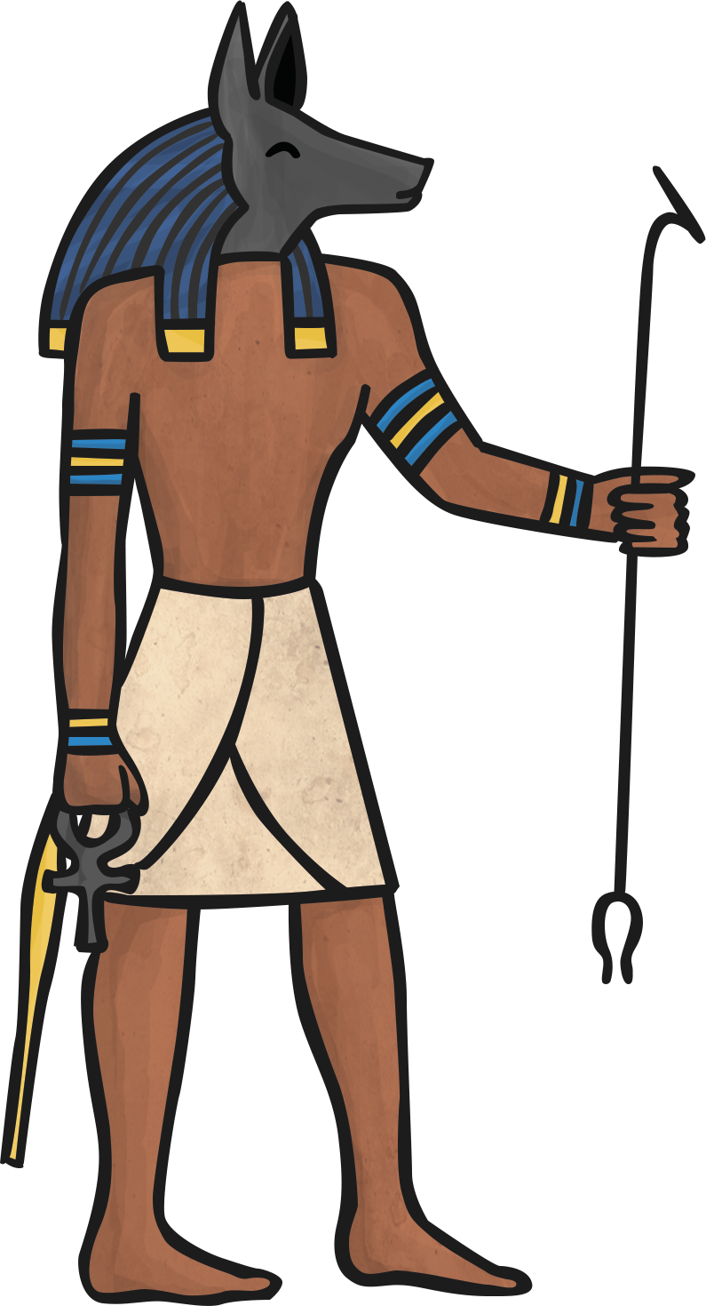
NAME: Anubis
GOD OF: the dead and the process of embalming
It was thought that jackals watched over the dead as they were seen in cemeteries a lot.
Anubis helped to embalm Osiris when he was killed by Seth.
Egyptian priests would wear a mask of Anubis during mummification ceremonies.

Slide 8
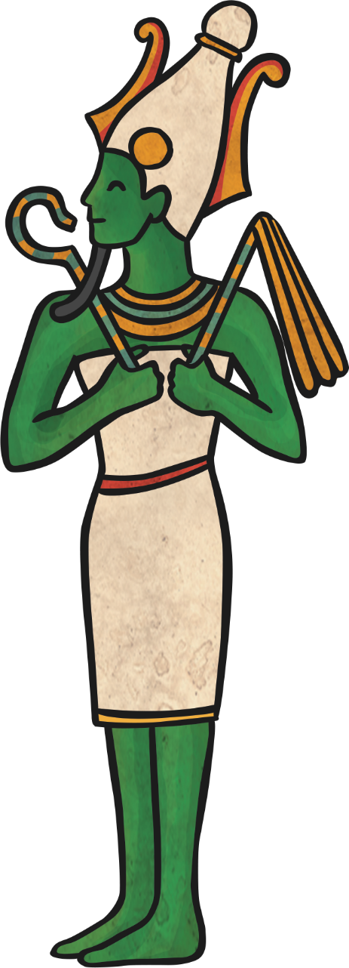
NAME: Osiris
GOD OF: the dead and the underworld.
Osiris was also a god of resurrection and fertility.
The Egyptians believed that he gave them the gift of their most important crop, barley.
Osiris was the husband of Isis and the father of Horus.

Slide 9
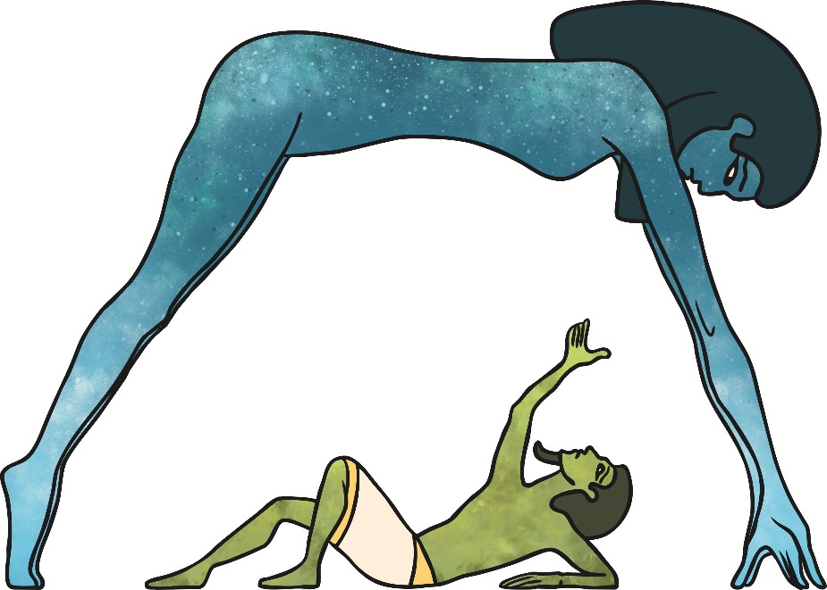
NAME: Nut and Geb
GOD/GODDESS OF: Nut – the sky, Geb – the earth
Nut’s body is stretched across the sky and covered in stars. She and Geb are the parents of Isis and Osiris.
Nut is the sister/wife of Geb and it is believed that Nut swallowed Ra, the sun god at the end of every day and gave birth to him again in the morning.
It was believed that earthquakes are caused by Geb’s laughing.

Slide 10
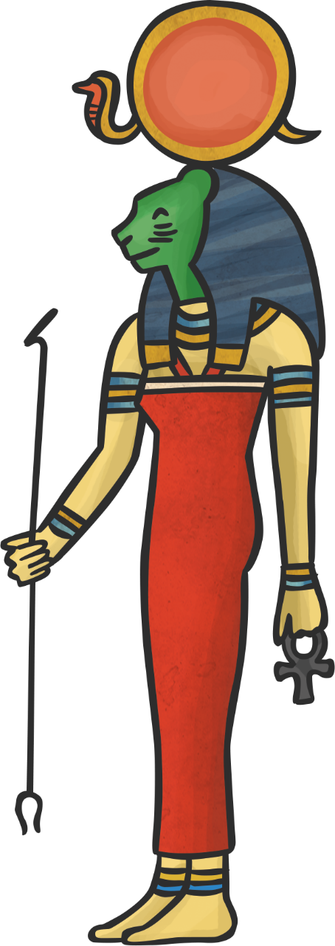
NAME: Sekhmet
GODDESS OF: war
Sekhmet means ‘the powerful one’!
She is sometimes called the daughter of the sun god Ra.
She is celebrated at the end of battles.

Slide 11
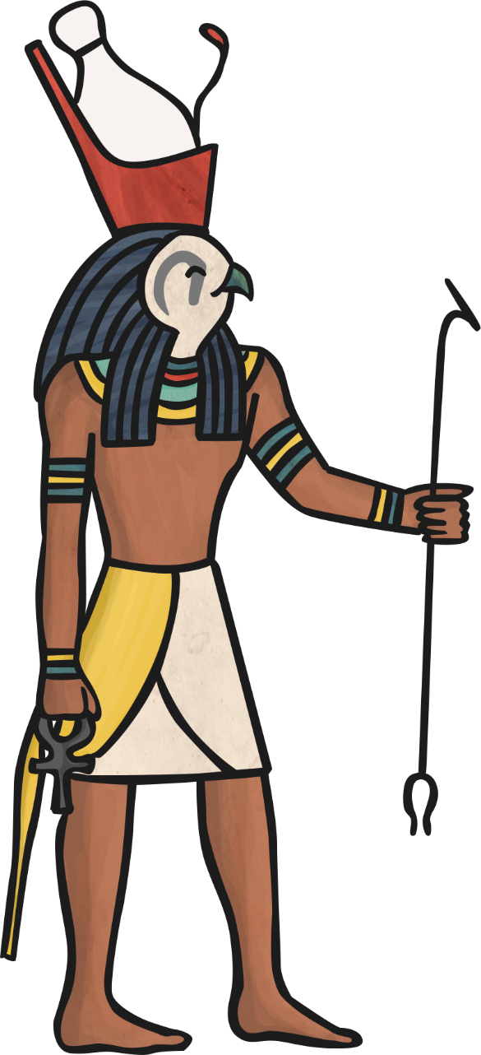
NAME: Horus
GOD OF: the sky
Protector and ruler of Egypt. All living pharaohs were considered a ‘living Horus’.
It was believed that Horus was the son of Isis and Osiris.
Horus became a ruler of the living after losing an eye in a battle and having it restored. The eye then became a symbol of protection.

Slide 12
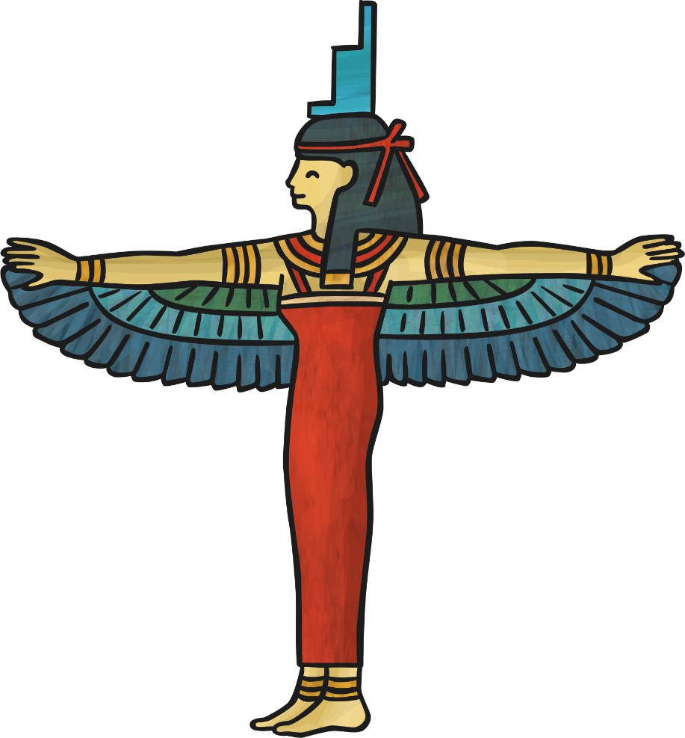
NAME: Isis
GODDESS OF: protecting the needy.
Isis is the wife of Osiris. Each pharaoh of the time was considered a ‘living Horus’ so she was very important as their wife.
She is also the mother of Horus and has him sitting on her lap.

Slide 13
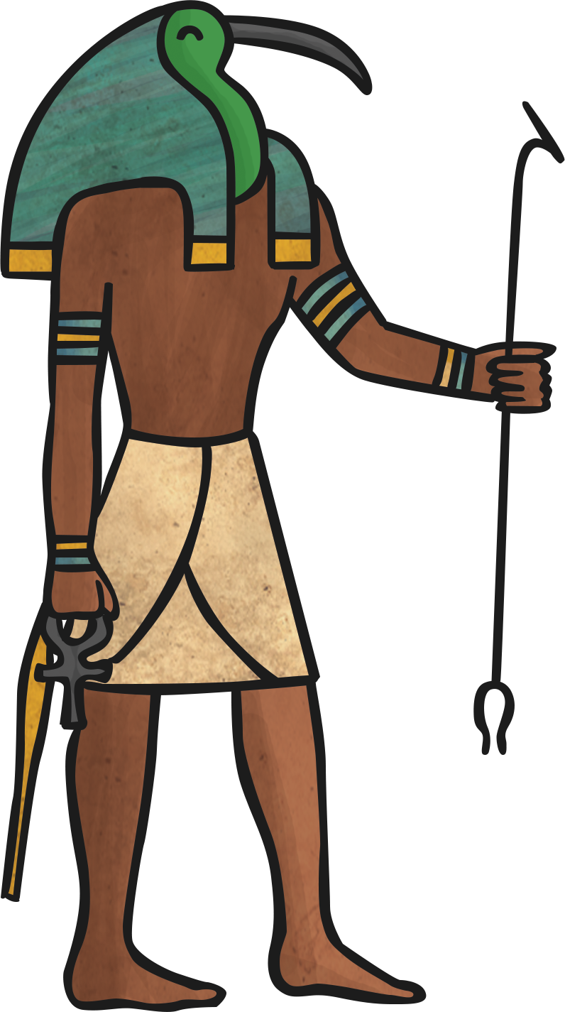
NAME: Thoth
GOD OF: writing and knowledge
Thoth could also appear as a baboon.
It was believed that Thoth gave the Egyptians the gift of hieroglyphs.

Slide 14
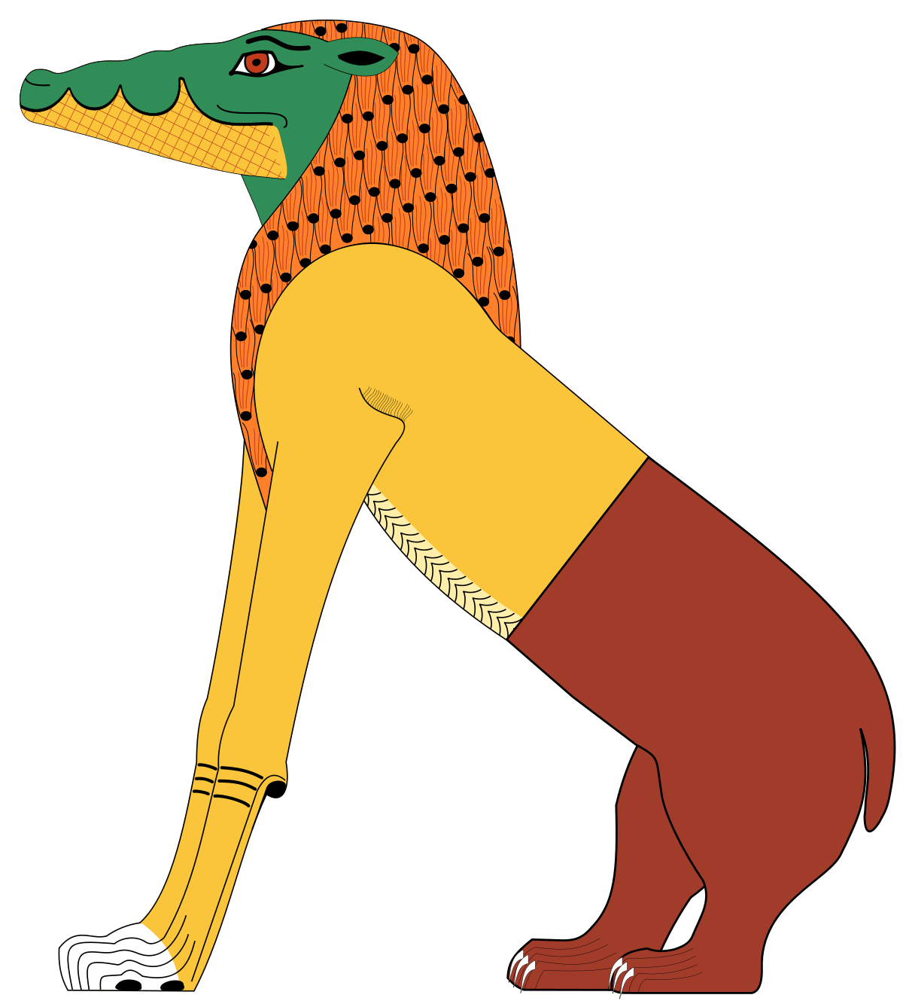
NAME: The Devourer
GOD OF: He ate the bad souls in the afterlife.
He was part crocodile, lion and hippo.
He was also known as Ammit.
He was made from the largest man eating animals in Ancient Egypt.

Slide 15
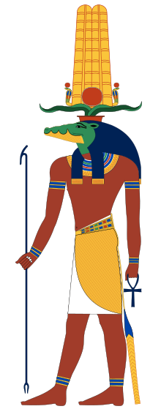
NAME: Sobek
GOD OF: The God of the Nile.
He brought water to the land to make the soil fertile.
He was also known as Lord of the waters.
He was very strong and powerful like water.

Slide 16
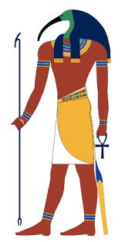

Thoth is the Egyptian god of writing, magic, wisdom, and the moon.
*Toth was the offspring of Horus (god of the sky).
*He was the inventor of writing.
*He weighed the hearts of the dead and reported to the other Gods.
Anubis was the god of embalming and the dead.
*Jackals were often seen in cemeteries
*Anubis watched over the dead.
*He guided the protected souls to the afterlife.
Sobek was the God of the Nile.
*He brought water to the land to make the soil fertile.
*He was also known as Lord of the waters.
*He was very strong and powerful like water.
The Devourer ate the bad souls in the afterlife.
*He was part crocodile, lion and hippo.
*He was also known as Ammit.
*He was made from the largest man eating animals in Ancient Egypt.

