Slide 1
Good Morning Badgers and Otters
I hope you are feeling safe and well. For today, I have produced another presentation that has all the information you need to complete your work at home for today, Friday 25th June.
All documents mentioned in this presentation are available to download from the school website under the LKS2 Class Pages tab, which can be found here:
https://www.allsaintsprimaryschoolmaldon.co.uk/lks2-2/
I hope you enjoy the lessons and whilst it is such a shame we are not in school for the next few days, I will endeavour to make sure we do not miss out on anything and I will make some videos, challenges, and topic lessons for you next week.
I would love to see any of your amazing work so please do email it to year34@allsaintsprimaryschoolmaldon.co.uk
Take care and stay safe,
Mr. Bearman :-)

Slide 2

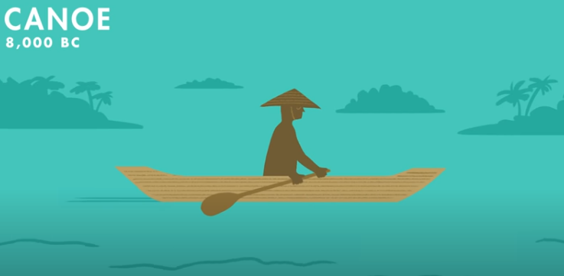
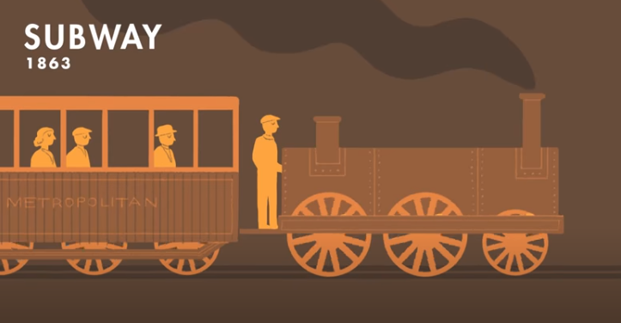
ENGLISH LESSON 1 - HISTORY OF TRANSPORT
Firstly, if you have not completed yesterday’s English please do this first as you will need it for next week.
As you know we have recently been looking at the history of transport. Today we are going to create a timeline of some of these forms of transport. Click on the link below to rewatch the history of transport video we watched in the first the first week of the topic.
VIDEO LINK: https://www.youtube.com/watch?v=FaLCQo8NJFA
After you have watched it, chose 6 forms of transport from the video and draw them on the timeline in chronological order in the large boxes. Then, label them in the small boxes beneath with their name and dates.
Challenge
Once you have put them in order and drawn the pictures and labelled your transport. Why don’t you try and research some facts about the forms of yransport and add them to your sheet.

Slide 3
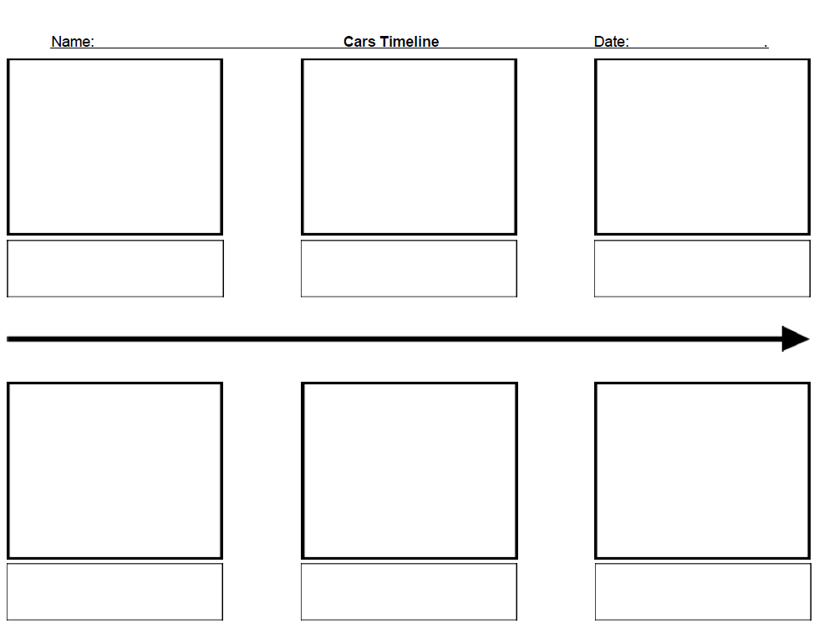
Use this sheet to present your timeline
Choose your transport and draw them in these boxes but make sure you have put them in chronological order.
Label you picture with the name of transport and the date.
You could also add any extra information about the form of transport in these boxes with the pictures.
THIS DOCUMENT CAN BE DOWNLOADED FROM THE WEBSITE!

Slide 4
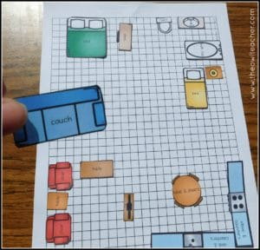
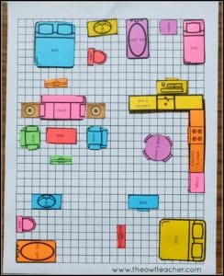
MATHS LESSON - AREA & PERIMETER PART 2
Your Maths task today is going to continue on from yesterday's area and perimeter lesson. If you are anything like me, I like to change the furniture in my room around a lot! It’s a great game and I love to experiment to see where it all fits perfectly.
Using the same squared paper as yesterday (or if you don't have any make your own) I want to you design your own apartment. It could have a bedroom area, a gaming area, a kitchen area, a dining area, a bathroom area or whatever you would like to put in it. You could draw the furniture on another piece of paper, cut them out, and stick them onto the squared paper. Have a look at the pictures on the right for inspiration. Then once you have completed that figure out both the area and perimeter of the furniture in each area of your apartment.
The area is the space inside the shape = Count the squares (for today’s activity count partial squares as whole squares)
The perimeter is the distance around the outside of the shape = Count the squares around the outside of the furniture.
Use the example shown to help you.
DOWNLOAD SQUARE PAPER FROM THE SCHOOL WEBSITE or HERE

Slide 5
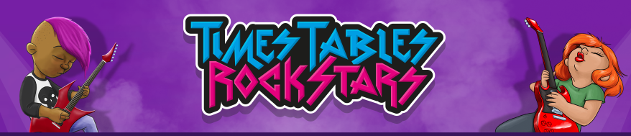
TTRockstars
Remember to practise your times tables by logging onto TT Rockstars and spending some time trying to lower your Rockstar speed.

Slide 6
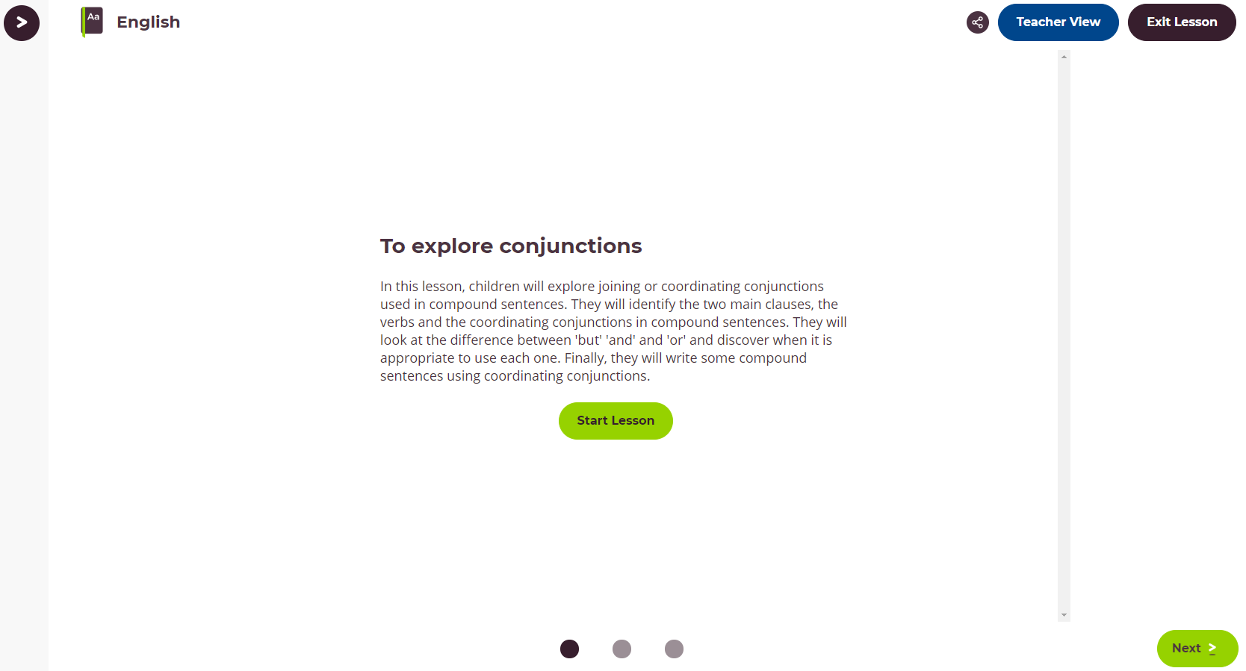
ENGLISH LESSON 2 - GRAMMAR LESSON
For your Grammar lesson today we would like you to complete this lesson from the Oak Academy website.
To explore conjunctions:
In this lesson, children will explore joining or coordinating conjunctions used in compound sentences. They will identify the two main clauses, the verbs and the coordinating conjunctions in compound sentences. They will look at the difference between 'but' 'and' and 'or' and discover when it is appropriate to use each one. Finally, they will write some compound sentences using coordinating conjunctions.
CLICK ON THE IMAGE TO GO TO THE WEBSITE
LINK

Slide 7
MUSIC LESSON
There is still time for you to have a go at Mrs Chilver’s musical challenge GOOD LUCK!
YOUR CHALLENGE:
Write a song for a car advert.
Using the tune to Frere Jacques change the words to sell your favourite car.
When you have the song, add sound effects from the BBC Sound Effect Library.
Search vehicles to find the best sounds. You could make a mix like we did with nature sounds.
You could record yourself singing with the sound effects in the background.
Frère Jacques (Instrumental): https://www.youtube.com/watch?v=6-JoTos8-oE
BBC Sound effects website: https://sound-effects.bbcrewind.co.uk/
This has also been set through Google Classroom if you would like to log in that way.

