Slide 1

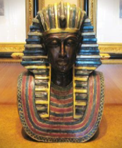
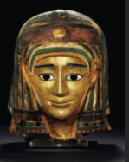
Ancient Egyptian
Ancient Masks
Ancient Egyptian
Death Masks

Slide 2
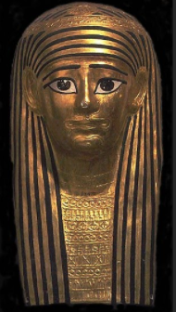
Death Masks
Ancient Egyptians believed that life on Earth was so special that they wanted it to last forever. Many believed that the next life was even better, so they spent a lot of time and effort preparing for it.
Preserving the body was very important for the journey to the afterlife. It was very important to preserve a body of the dead because the soul has to have a place to dwell after the death.

Slide 3
Death Masks
Preservation of the dead body was done by mummification. It was considered very important for the soul to be able to recognize the body so it can return to it. For that reason, death masks were used. They were also used to protect and preserve.
Not only did the death mask have to look like the deceased but it had to be appealing to the gatekeepers of the afterlife. so they often depicted the deceased when they were young. They had slightly enlarged eyes and a faint smile and also showed the fashion of the moment, with painted jewellery and make up.

Slide 4
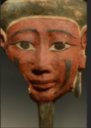
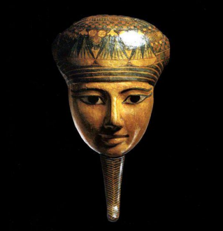
Death Mask Materials
Death masks were made in the likeness of the deceased and from different materials. Early masks were made from wood, in two pieces and connected with pegs.
After that Egyptians used, so called, cartonnage, a material made from papyrus or linen and soaked in plaster and then moulded on a wooden mould. That was, of course, a cheap alternative intended for the lower class. It could then be painted to look like solid gold at a fraction of the cost.

Slide 5
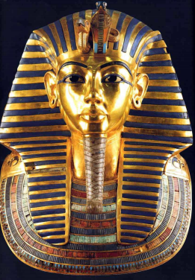
Royal Death Masks
Royal death masks were made from precious metals, first of all - gold or gold leaves on bronze. One of the most famous death masks is the mask of the Tutankhamun.

Slide 6
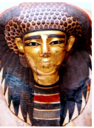
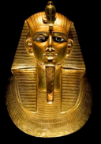
Look carefully at the examples of Death Masks
on the next slide…
What patterns can you spot?
Are there any symbols used?
What do they mean?
What colours have been used?
Are they symmetrical?

Slide 7
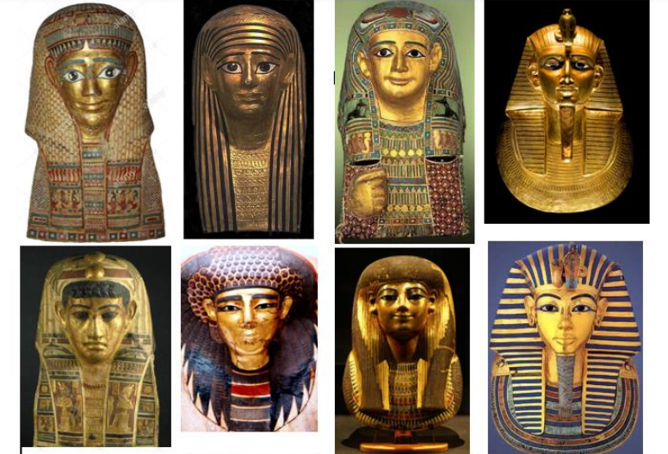

Slide 8
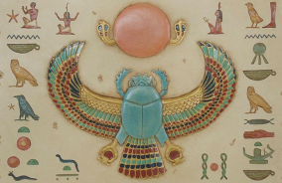
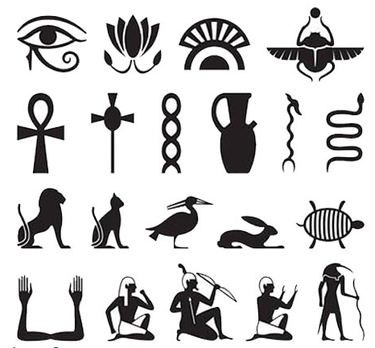
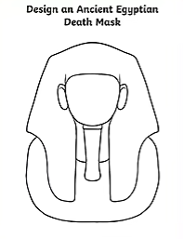
Your Task
You are an Ancient Egyptian mask designer and have been asked to design the mask for the burial of the Pharaoh (it could be a male or female) on paper.
Think carefully about:
Patterns, symbols and their meaning.
You could include hieroglyphics, colours and symmetry.
Remember to think about:
Why did they make a death mask?
What were they made from?/How were they made?
What were they made to look like?

