Slide 1
Good Morning Badgers and Otters - Welcome to Tuesday 29th June 2021
I hope you are feeling safe and well. I have again produced a presentation that has all the details you need to complete your day’s lessons.
I have also completed a video to talk you through the lessons and task.s. I will again go through the day first before going back to add more detail to the lesson that need more explanation.
All documents mentioned in this presentation are available to download from the school website under the LKS2 Class Pages tab, which can be found here:
https://www.allsaintsprimaryschoolmaldon.co.uk/lks2-2/
I would love to see any of your amazing work so please do email it to year34@allsaintsprimaryschoolmaldon.co.uk
Take care and stay safe,
Mr. Bearman :-)

Slide 2
List of lessons for Tuesday 29th June 2021
Lesson | Information
English Writing/Grammar | A carousel of activities to help prepare you for your writing on Wednesday. Past Tense 3rd Person Conjunctions (time)
Maths | “Sandcastles” and “Circle Sums” Maths Challenges
Art | How To Draw….. With Arts For Kids Hub
PE | Running over obstacles and throwing for accuracy (You will need some space for these activities, preferably outside in the Garden. There is an alternative lesson if space is not available.)
Each day I will give you a list of lessons and resources however, the order you complete them or the amount of time you give to each activity is up to you. I encourage you to try your hardest but I fully understand that everyone will be working to a different timetable.

Slide 3

English Writing/ Grammar Activities
Tuesday 29th June 2021

Slide 4
Tuesday 29th June 2021
Activity 1: Past Tense
Take the sentences below and rewrite them use the past tense of the verb that is underlined in red.
Dick Dastardly flies around the racetrack.
The Slag Brothers grab their stone car and chase after Penelope.
Perfect Pete speeds around the corner, almost hitting the others.
The cars whizz around the track.
The bend approaches and four cars crash into each other.
The Gruesome Twosome swing around the corner, heading for the final straight.
Professor Pat quickly changes gear and overtakes the Gruesome Twosome.

Slide 5
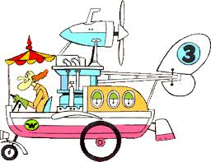
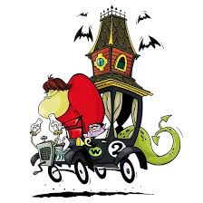


Tuesday 29th June 2021
Activity 2: 3rd Person
In third-person point of view, the author is narrating a story about the characters, referring to them by name, or using the third-person pronouns “he,” “she,” and “they.”
These sentences are written in the first or second person. With a partner, say them in the third person.
I am going to jump over all the other cars and win the race!
We need to go faster to get in front of all those other competitors.
I am Red Max, the fastest of all the cars around here!
You are not going to beat me, I am the quickest lady around the town.

Slide 6
Tuesday 29th June 2021
Activity 2: 3rd Person
Now, using the other characters from the Wacky Races write 5 sentences of your own in the 3rd person. Try and make them interesting!

Slide 7


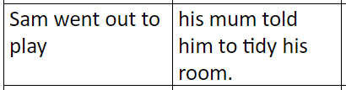

Tuesday 29th June 2021
Activity 3: Conjunctions
Below are a list of sentences. You need to put the sentences together using a conjunction puzzle piece. In between them to make the completed sentence make sense.
You can cut them out and stick them down or just copy them down. Try and answer 8-10 of your choice

Slide 8
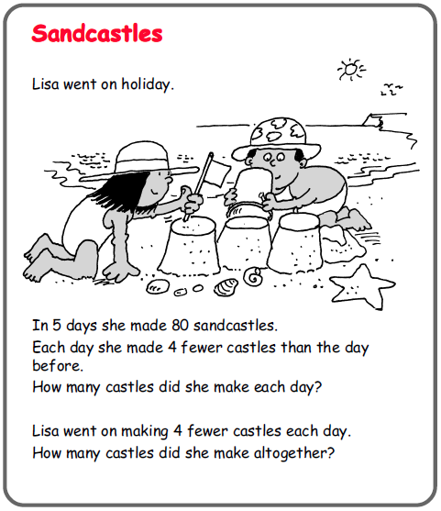
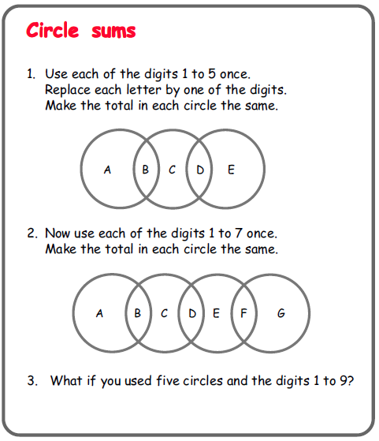
Maths Lesson
Tuesday 29th June 2021
For Maths today, I have chosen another two maths activities to challenge your problem solving skills.
The instructions are in the activities and you can display the answer how you like.
Good luck - today I found the sandcastle challenge the hardest.
I hope you are better at it than I was!

Slide 9
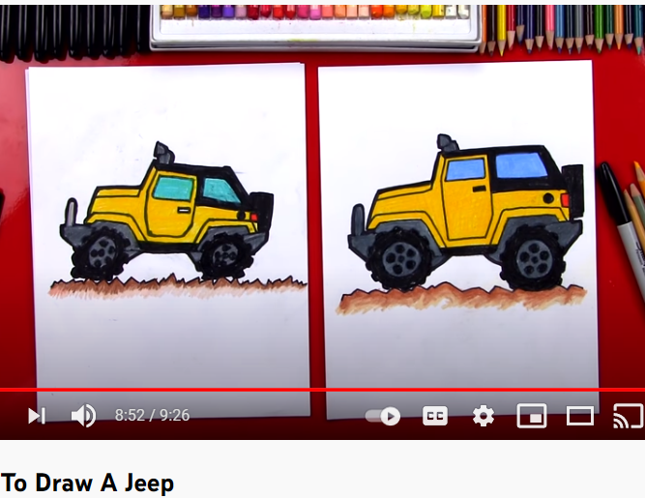
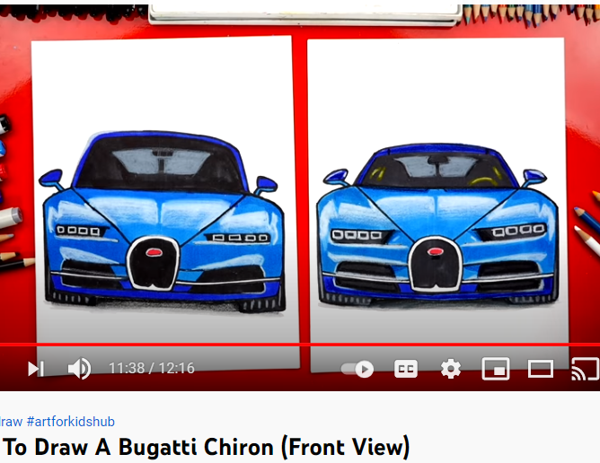
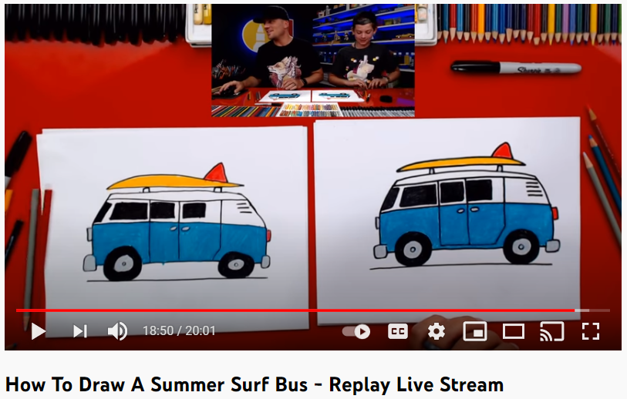
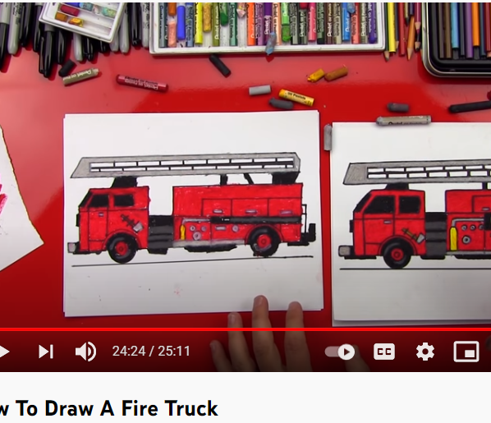
ART Lesson
Tuesday 29th June 2021
How to Draw…. (Art for Kids Hub)
I have been very impressed with some of your drawings in your topic work and your Wacky Races work, over the last few days. I really enjoy watching these “How to Draw…” so I have found a few that you might like to have a go doing as they relate to our TopGear Topic. Have fun! To watch the clips, click on the description below or the image.
How to Draw A Jeep
How to Draw A
Bugatti Chiron
How to Draw A Summer
Surf Bus
How to Draw A
Fire Engine

Slide 10
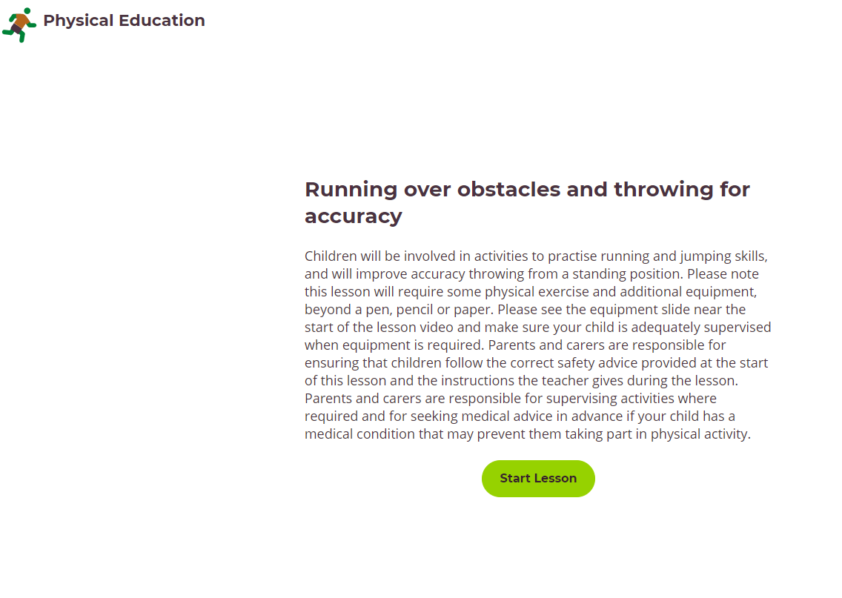
PE Lesson
Tuesday 29th June 2021
Running over obstacles and throwing for accuracy
Children will be involved in activities to practise running and jumping skills, and will improve accuracy throwing from a standing position. Please note this lesson will require some physical exercise and additional equipment, beyond a pen, pencil or paper. Please see the equipment slide near the start of the lesson video and make sure your child is adequately supervised when equipment is required. Parents and carers are responsible for ensuring that children follow the correct safety advice provided at the start of this lesson and the instructions the teacher gives during the lesson. Parents and carers are responsible for supervising activities where required and for seeking medical advice in advance if your child has a medical condition that may prevent them taking part in physical activity. CLICK HERE or ON THE IMAGE TO GO TO THE WEBSITE
YouTube PE Lesson
If you are unable to take part i the above lesson due to lack of space then please use one of these lesson to help you. You should remember them from the last lockdown
VIDEO ONE VIDEO TWO VIDEO THREE
These videos are filmed by an American PE Coach so there are some American references that you might not know :-)

