Slide 1
Good Morning Badgers and Otters - Welcome to Monday 28th June 2021
I hope you are feeling safe and well and were able to rest up over the weekend. Each day I will produce a presentation that has all the details you need to complete your day’s lessons.
I will also do a video to talk you through the lessons and task.s. I will go through the day first before going back to add more detail to the lesson that need more explanation.
All documents mentioned in this presentation are available to download from the school website under the LKS2 Class Pages tab, which can be found here:
https://www.allsaintsprimaryschoolmaldon.co.uk/lks2-2/
I would love to see any of your amazing work so please do email it to year34@allsaintsprimaryschoolmaldon.co.uk
Take care and stay safe,
Mr. Bearman :-)

Slide 2
List of lessons for Monday 28th June 2021
Lesson | Information
English Writing | Get to know your Wacky Races Characters!
English Grammar | To explore the function of apostrophes
Maths | “Rows of Coins” and “Kieron’s Cats” Maths Challenges
Topic | Planning Your Wacky Races Race course
PE | Running over obstacles and throwing for accuracy (You will need some space for these activities, preferably outside in the Garden. There is an alternative lesson if space is not available.)
Each day I will give you a list of lessons and resources however, the order you complete them or the amount of time you give to each activity is up to you. I encourage you to try your hardest but I fully understand that everyone will be working to a different timetable.

Slide 3

WALT: get to know the Wacky Races characters
Monday 28th June 2021

Slide 4
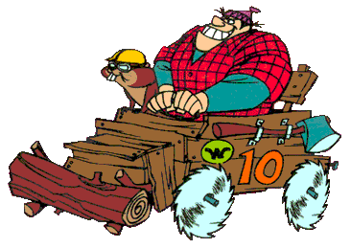
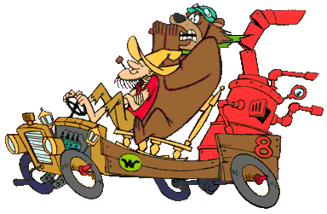

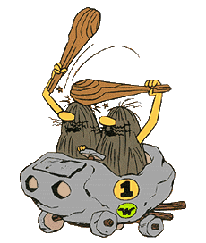



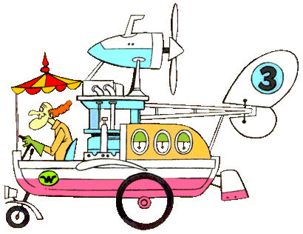
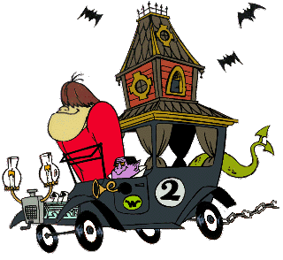



Slide 5
Have a look through the slides which give you lots of information about all the Wacky Races Characters. If you want you can re-watch some of the clips from Thursday’s lesson to help familiarise yourself with all the characters.
In this lesson, you are going to choose 3 characters that you will include in your own race later in your Topic Lesson.
Once you have chosen your 3 characters. I would like you to draw all three on one piece of paper with all their facts around them so you can use it as a writing prop later in the week. I have done an example on the next slide.

Slide 6
The extra characters I would like to have in my race are:
Car:
The Mean Machine
Driver:
Dick Dastardly and Muttley - the villain
Rocket powered car with lots of weapons.
Sole aim to win every race by hook or crook. Drat and Double Drat!
Car:
The Boulder Mobile - a wheeled boulder.
Driver:
The Slag Brothers (Rock Slag and Gravel Slag) - cavemen
The Slag Brothers sometimes reconstructed their car from scratch using their clubs.
Car:
The Compact Pussycat
Driver:
Penelope Pitstop - woman racer
Pink, feminine car with personal grooming facilities.
Shampoo foam hitting in faces.

Slide 7
Wacky race Characters
Car:
The Boulder Mobile - a wheeled boulder.
Driver:
The Slag Brothers (Rock Slag and Gravel Slag) - cavemen
The Slag Brothers sometimes reconstructed their car from scratch using their clubs.

Slide 8
Wacky race Characters
Car:
The Creepy Coupe
Driver:
The Gruesome Twosome (Big and Little) - monsters
The car has a belfry, the belfry housed a dragon and various ghosts and ghouls.
Able to fly short distances through the use of dragon wings.

Slide 9
Wacky race Characters
Car:
Covert-a-Car
Driver:
Professor Pat Pending
Professor Pat Pending is a mad scientist.
The car can change into just about anything that moves.

Slide 10
Wacky race Characters
Car:
The Crimson Haybailer
Driver:
Red Max - an air ace
Car/Plane hybrid that was capable of limited flight, usually just enough to leapfrog over racers and obstacles.
Has a machine gun mounted.

Slide 11
Wacky race Characters
Car:
The Compact Pussycat
Driver:
Penelope Pitstop - woman racer
Pink, feminine car with personal grooming facilities.
Shampoo foam hitting in faces.

Slide 12
Wacky race Characters
Car:
The Army Surplus special
Driver:
Sergeant Blast and Private Meekly - soldiers
Army jeep/tank hybrid
The Army Surplus Special made use of its tank facilities while racing including its canon.

Slide 13
Wacky race Characters
Car:
The Bullet-Proof Bomb (The Roaring Plenty)
Driver:
The Ant Hill Mob
A new sentient car, Chugga Boom.

Slide 14
Wacky race Characters
Car:
The Arkansas Chuggabug
Driver:
Luke and Blubber Bear
Hillbillies in a wooden buggy driven by a coal-fired range

Slide 15
Wacky race Characters
Car:
The Turbo Terrific
Driver:
Peter Perfect- All American Jock
Has a crush on Penelope - so often that he stopped to help
Driving a drag racer that regularly fell to bits.

Slide 16
Wacky race Characters
Car:
The Buzz Wagon
Driver:
Rufus Ruffcut and Sawtooth
A lumberjack and a beaver in a wagon with buzzsaws for wheels, which gave it the ability to cut through almost anything, damaging and destroying the object in the process.

Slide 17
Wacky race Characters
Car:
The Mean Machine
Driver:
Dick Dastardly and Muttley - the villain
Rocket powered car with lots of weapons.
Sole aim to win every race by hook or crook. Drat and Double Drat!

Slide 18
The extra characters I would like to have in my race are:
Car:
The Mean Machine
Driver:
Dick Dastardly and Muttley - the villain
Rocket powered car with lots of weapons.
Sole aim to win every race by hook or crook. Drat and Double Drat!
Car:
The Boulder Mobile - a wheeled boulder.
Driver:
The Slag Brothers (Rock Slag and Gravel Slag) - cavemen
The Slag Brothers sometimes reconstructed their car from scratch using their clubs.
Car:
The Compact Pussycat
Driver:
Penelope Pitstop - woman racer
Pink, feminine car with personal grooming facilities.
Shampoo foam hitting in faces.

Slide 20
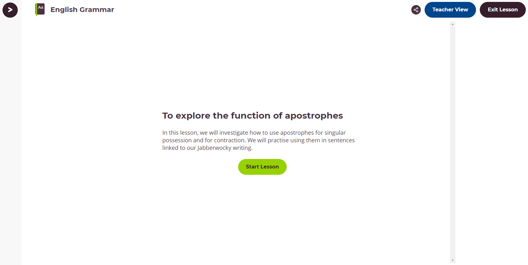
English Grammar
Monday 28th June 2021
For your Grammar lesson today we would like you to complete this lesson from the Oak Academy website.
To explore the function of apostrophes:
In this lesson, we will investigate how to use apostrophes for singular possession and for contraction.
CLICK ON THE IMAGE TO GO TO THE WEBSITE

Slide 21


Maths Lesson
Monday 28th June 2021
For Maths today, I have two challenges for you to complete.
The instructions are in the challenges and you can display the answer how you like.
Good luck - Kieron’s Cats challenge took me ages to work out the answer!
I hope you are better at it than I was!

Slide 22
Monday 28th June 2021
For Maths today, I have two challenges for you to complete.
The instructions are in the challenges and you can display the answer how you like.
Good luck - Kieron’s Cats challenge took me ages to work out the answer!
I hope you are better at it than I was!

Slide 23
WALT: to plan the race - Lesson 2
Topic Lesson
Monday 28th June 2021

Slide 24
Where is your race going to be held?
Mountains
Hot desert
Antarctica
An urban city
Forest

Slide 25
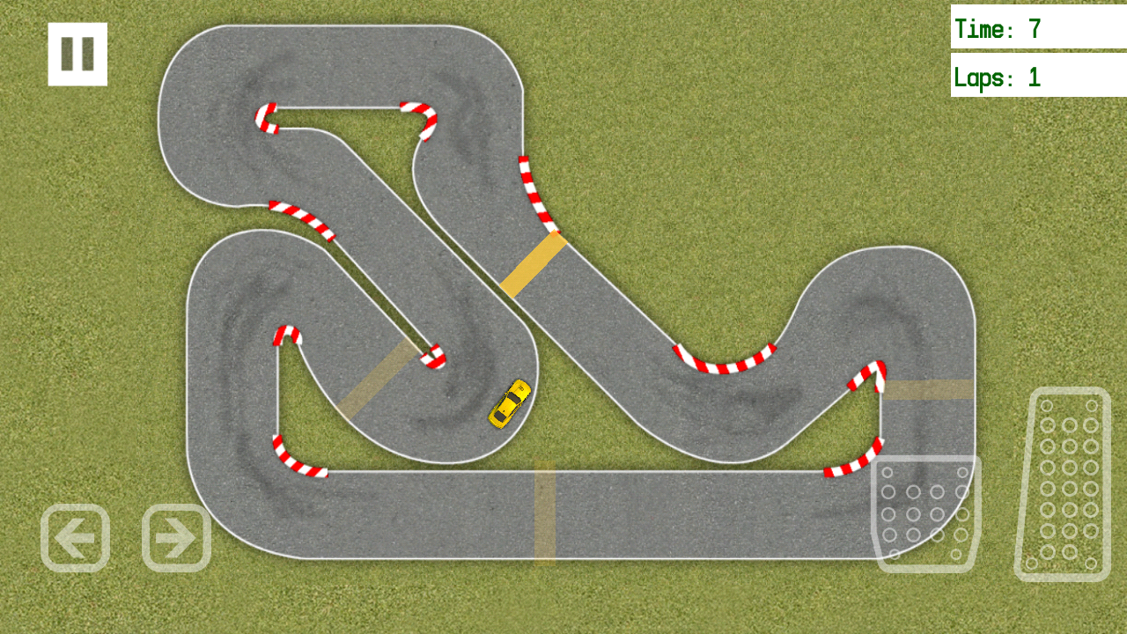

Slide 26
The 4 problems
During the race your character will need to come across several problems. This race isn’t going to be plain sailing!
For example:
Crashing
Being overtaken
Being targeted by another driver
Using post it notes on your racetrack add in where your problems will occur. What happens? Who is involved?

Slide 27
Miss Mastermind is overtaken by Penelope Pitstop!

Slide 28

PE Lesson
Monday 28th June 2021
Running over obstacles and throwing for accuracy
Children will be involved in activities to practise running and jumping skills, and will improve accuracy throwing from a standing position. Please note this lesson will require some physical exercise and additional equipment, beyond a pen, pencil or paper. Please see the equipment slide near the start of the lesson video and make sure your child is adequately supervised when equipment is required. Parents and carers are responsible for ensuring that children follow the correct safety advice provided at the start of this lesson and the instructions the teacher gives during the lesson. Parents and carers are responsible for supervising activities where required and for seeking medical advice in advance if your child has a medical condition that may prevent them taking part in physical activity. CLICK HERE or ON THE IMAGE TO GO TO THE WEBSITE
YouTube PE Lesson
If you are unable to take part i the above lesson due to lack of space then please use one of these lesson to help you. You should remember them from the last lockdown
VIDEO ONE VIDEO TWO VIDEO THREE
These videos are filmed by an American PE Coach so there are some American references that you might not know :-)

