Slide 1
Good Morning Badgers and Otters - Welcome to Friday 2nd July 2021
I hope you are feeling safe and well. I have again produced a presentation that has all the details you need to complete your day’s lessons.
I have also completed a video to talk you through the lessons and task.s. I will again go through the day first before going back to add more detail to the lesson that need more explanation.
All documents mentioned in this presentation are available to download from the school website under the LKS2 Class Pages tab, which can be found here:
https://www.allsaintsprimaryschoolmaldon.co.uk/lks2-2/
I would love to see any of your amazing work so please do email it to year34@allsaintsprimaryschoolmaldon.co.uk
Take care and stay safe,
Mr. Bearman :-)

Slide 2
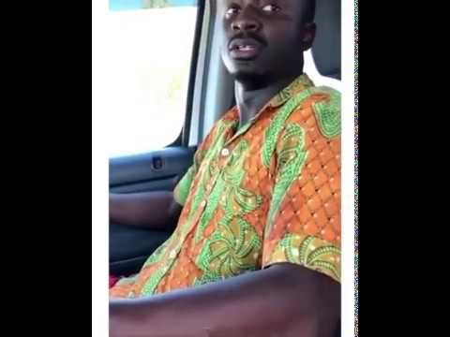
Good Morning Badgers and Otters - Welcome to Friday 2nd July 2021

Slide 3
List of lessons for Friday 2nd July 2021
Lesson | Information
English Writing | WALT: write a recount (Wacky Races recount)
Maths | Moving on a Grid
PSHE | A Time for Reflection
Each day I will give you a list of lessons and resources however, the order you complete them or the amount of time you give to each activity is up to you. I encourage you to try your hardest but I fully understand that everyone will be working to a different timetable.

Slide 4

WALT: writing the recount
Friday 2nd July 2021

Slide 5
Structure
Introduction
Situation 1
Situation 2
Situation 3
Situation 4
Conclusion

Slide 6
Structure
Introduction
Starting the race. How do you feel?
CHALLENGE YOURSELF
Can you include:
A simile
Personification
A sentence starting with an ing word
At least 5 Conjunctions - A WHITE BUS
Situation 1
What happens? How do you feel?
Situation 2
What happens? How do you feel?
Situation 3
What happens? How do you feel?
Situation 4
What happens? How do you feel?
Conclusion
How does the race end? Do you win or somebody else? Do you make it?

Slide 7
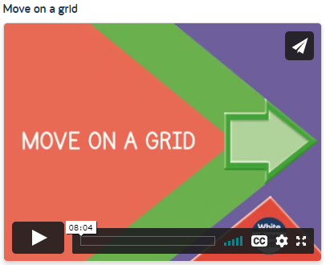
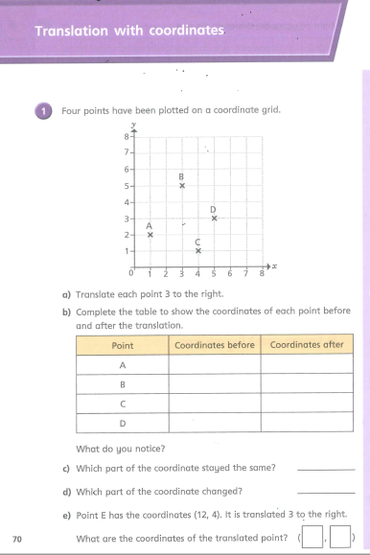
Maths Lesson - Draw on a Grid
Friday 2nd July 2021
For Maths today, I have chosen another lesson from the WhiteRose Maths home learning website.
Try your hardest to do as much as you can. I will also post the answers on the website so you can check your work.
Good luck!
Click on this LINK. and choose the lesson called “Move on a Grid”
Follow the lesson and do the practise questions as you watch the video. Then complete the related worksheet, which is pictured on the right.
(The worksheet is on the school website)

Slide 8
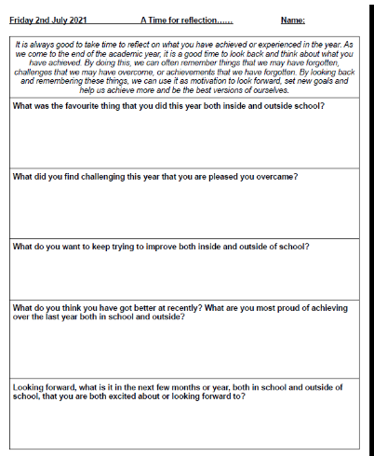
A Time for Reflection
Friday 2nd July 2021
Link to worksheet

