Slide 1
Good Morning Badgers and Otters - Welcome to Thursday 1st July 2021
I hope you are feeling safe and well. I have again produced a presentation that has all the details you need to complete your day’s lessons.
I have also completed a video to talk you through the lessons and task.s. I will again go through the day first before going back to add more detail to the lesson that need more explanation.
All documents mentioned in this presentation are available to download from the school website under the LKS2 Class Pages tab, which can be found here:
https://www.allsaintsprimaryschoolmaldon.co.uk/lks2-2/
I would love to see any of your amazing work so please do email it to year34@allsaintsprimaryschoolmaldon.co.uk
Take care and stay safe,
Mr. Bearman :-)

Slide 2
List of lessons for Thursday 1st July 2021
Lesson | Information
English Writing | WALT: write a recount (Wacky Races recount)
Maths | Draw on a Grid
Science | Science Lesson - Friction in Action
Music | Mrs Chilver’s Musical Challenge 2.0
Each day I will give you a list of lessons and resources however, the order you complete them or the amount of time you give to each activity is up to you. I encourage you to try your hardest but I fully understand that everyone will be working to a different timetable.

Slide 3
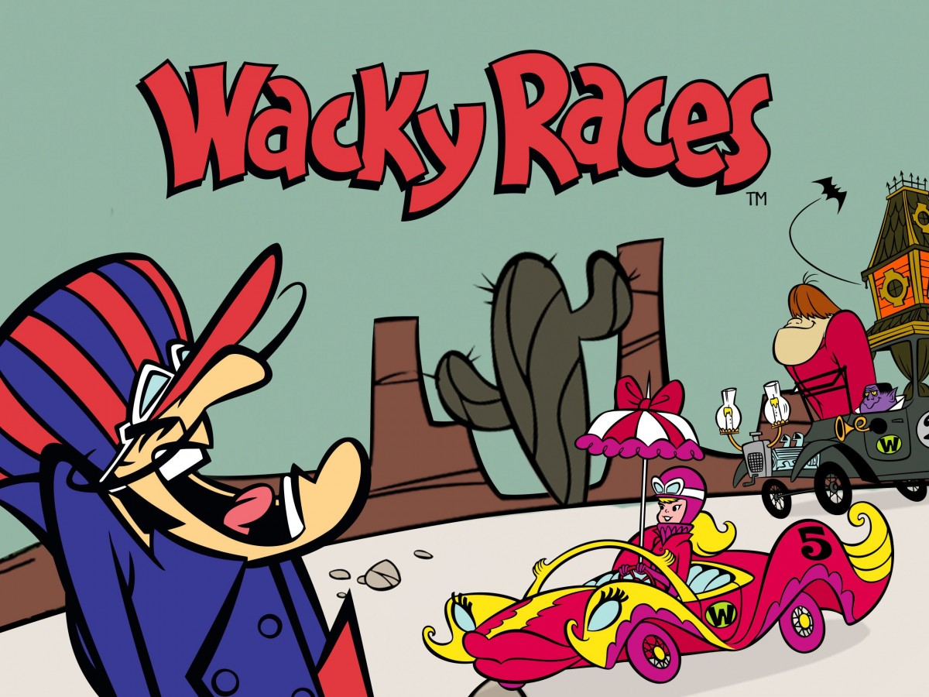
WALT: writing the recount
Thursday 1st July 2021

Slide 4
Structure
Introduction
Situation 1
Situation 2
Situation 3
Situation 4
Conclusion

Slide 5
Structure
Introduction
Starting the race. How do you feel?
CHALLENGE YOURSELF
Can you include:
A simile
Personification
A sentence starting with an ing word
At least 5 Conjunctions - A WHITE BUS
Situation 1
What happens? How do you feel?
Situation 2
What happens? How do you feel?
Situation 3
What happens? How do you feel?
Situation 4
What happens? How do you feel?
Conclusion
How does the race end? Do you win or somebody else? Do you make it?

Slide 6
Recount - Wacky Racer Story
Finally, the day had arrived. It was my time to shine. My first ever ‘Wacky Race’ in the scorching, sweltering Sahara desert. It was going to be the ultimate test of strength and determination. Feeling the excitement dance from my fingers to my toes made me a little queasy but I was ready.
Approaching the starting line, I glanced across at my opponents. Penelope Pitstop, Dick Dastardly and Peter Perfect. What a line-up! Thrilled, excited but a little worried, I cautiously checked my brake pads. Everything had to be perfect. Everything.
5, 4, 3, 2, 1 AND WE ARE OFF! Emerald green flags waved in the air and the challenge had commenced.

Slide 7
Recount - Wacky Racer Story
In the blink of an eye, I was zooming down the racetrack, as I had made a quick getaway. My tires screeched across the black tarmac like my own personal fingerprint left behind me. Just then, Penelope Pitstop was on my tail creeping up on me. Inch by inch, getting closer and closer. What was I going to do? I needed to stop her somehow?
Suddenly, an ingenious idea sprung into my mind. As I reached for the red button in front of me, my heart began to palpitate. Was my plan going to work? An ear piercing BEEP sounded from the engine and before I knew it... WOOSH!!! Penelope was picked up and launched far into the distance by a huge whirlwinding tornado. “Gotcha!” I cheered. However, I was so focused on sabotaging Penelope that I didn't notice Dick Dastardly whizzing into the lead! Oh no…

Slide 8
Structure
Introduction
Starting the race. How do you feel?
CHALLENGE YOURSELF
Can you include:
A simile
Personification
A sentence starting with an ing word
At least 5 Conjunctions - A WHITE BUS
Situation 1
What happens? How do you feel?
Situation 2
What happens? How do you feel?
Situation 3
What happens? How do you feel?
Situation 4
What happens? How do you feel?
Conclusion
How does the race end? Do you win or somebody else? Do you make it?

Slide 9
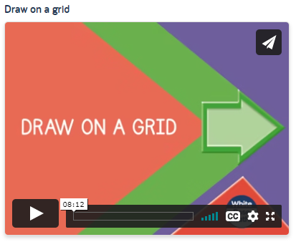
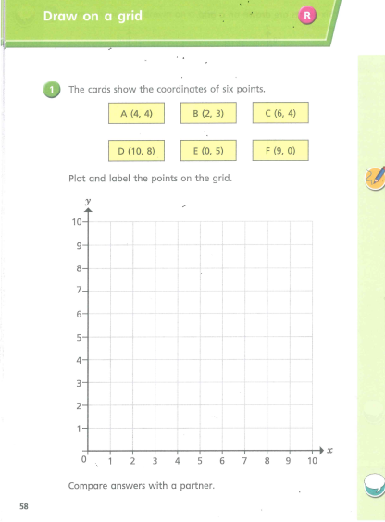
Maths Lesson - Draw on a Grid
Thursday 1st July 2021
For Maths today, I have chosen another lesson from the WhiteRose Maths home learning website.
Try your hardest to do as much as you can. I will also post the answers on the website so you can check your work.
Good luck!
Click on this LINK. and choose the lesson called “Draw on a Grid”
Follow the lesson and do the practise questions as you watch the video. Then complete the related worksheet, which is pictured on the right.
(The worksheet is on the school website)

Slide 10
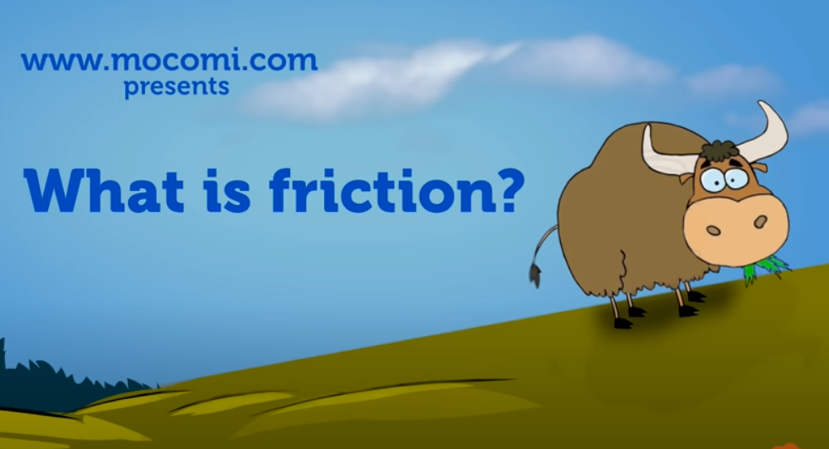
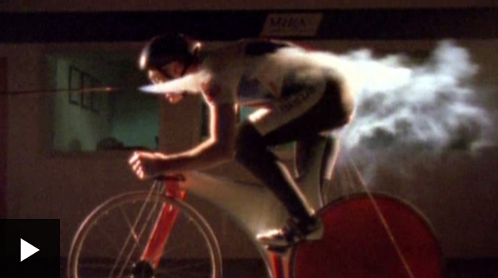
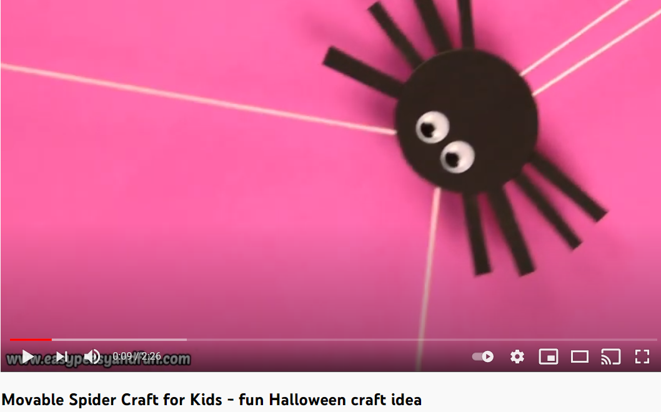
Science Lesson - Friction in Action
Thursday 1st July 2021
In Science we have been looking at Forces and in particular, we have looked at Friction. Firstly, I would like you to watch the first two videos, which will help to remind you about friction and what it is. The second video is a short clip showing lots of surfaces moving closely together and different levels of friction. Then once you have watched these we have an activity for you to do. It is a craft activity that uses friction to make a movable Spider that can go up and down using friction. The Activity video is below.
You will need:
Card, masking tape, straws (or homemade straws from card/paper, glue, pencil and thin string
Video One
Video Two
Activity Video

Slide 11
Music Lesson
Thursday 1st July 2021
Mrs Chilver’s Music Challenge!
Go to Google Classroom and you will see Mrs Chilver’s new challenge. It is a singing challenge that will help us when we return to school. Please give it your best shot!

