Slide 1
Good Morning Year 3/4
Unfortunately for us we have been forced back into some homeschooling for a short period of time. For today, we have produced this presentation that has all the information you need to complete your work at home.
All documents mentioned in this presentation are available to download from the school website under the LKS2 Class Pages tab, which can be found here:
https://www.allsaintsprimaryschoolmaldon.co.uk/lks2-2/
We hope you enjoy the lessons and we would love to see any of your amazing work so please do email it to year34@allsaintsprimaryschoolmaldon.co.uk
Take care and stay safe,
The Year 3/4 Team :-)

Slide 2

ENGLISH LESSON 1 - WACKY RACES
As you know we have recently been focusing on Wacky Races and have been looking at all of the different characters involved in the programme. You have already chosen 3 other characters to be in your race and the 4th will be your own car design!
What you will need to do today will be a final design of your own car and character.
Remember to think about trying to fit it in with the a Wacky Racer theme.
What theme could your car have?
Any sport, animal, space, knights and castles, ancient egyptians, romans, vikings, nature, futuristic
Your character will be you but obviously you will need to fit in with the other Wacky Racers.
What type of racer will your character be?
Someone who tries to sabotage the race? Someone who uses special abilities on other racers? Someone who does not interfere with anyone else.
https://www.dailymotion.com/video/x6l30zf
https://www.dailymotion.com/video/x6l30u9
https://www.dailymotion.com/video/x6l30y2
https://www.dailymotion.com/video/x6my3d6
Watch these links to remind yourself of the different characters and their personalities.

Slide 3
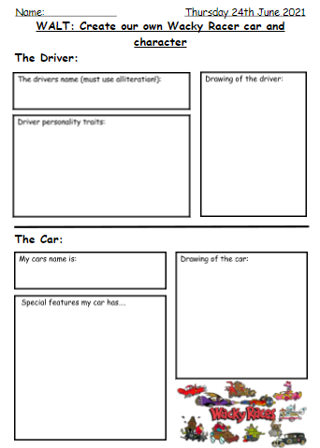

Use this sheet to present your final design.
This will be your name followed by an adjective beginning with the same letter. E.g. Peter Perfect.
This is where you will talk about what type of racer you will be.
A simple drawing, this is not an art lesson, but make sure it is not a rushed scribble.
In this section you need to think about what abilities your car will have. E.g. Professor Pat Pending’s car can turn into anything.
The Creepy Coupe has powers linked to a haunted house.
LINK THE SPECIAL FEATURES TO YOUR THEME!
THIS DOCUMENT CAN BE DOWNLOADED FROM THE WEBSITE!

Slide 4
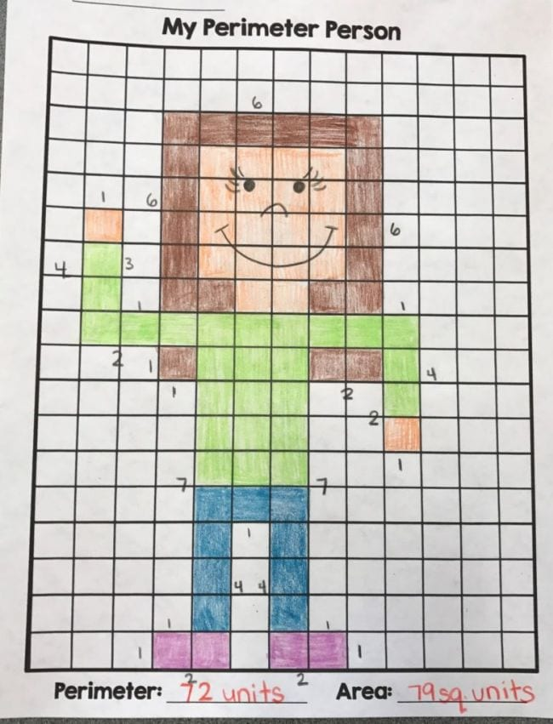
MATHS LESSON - AREA & PERIMETER
Your Maths task today is to draw a ‘Perimeter Person’.
Using graph paper (or if you don't have any make your own) draw a picture of yourself in squares like the image shown below. Then once you have completed that figure out both the area and perimeter of your person.
The area is the space inside the shape = Count the squares
The perimeter is the distance around the outside of the shape = Count the squares around the outside
Use the example shown to help you.
DOWNLOAD SQUARE PAPER FROM THE SCHOOL WEBSITE or HERE
CHALLENGE!
Can you use half squares within your ‘Perimeter Person’?
Then, colour in your person, then can you count the area of each of the individual colours?
For example in the example shown,
Green = 25 square units
Blue = 9 square units

Slide 5
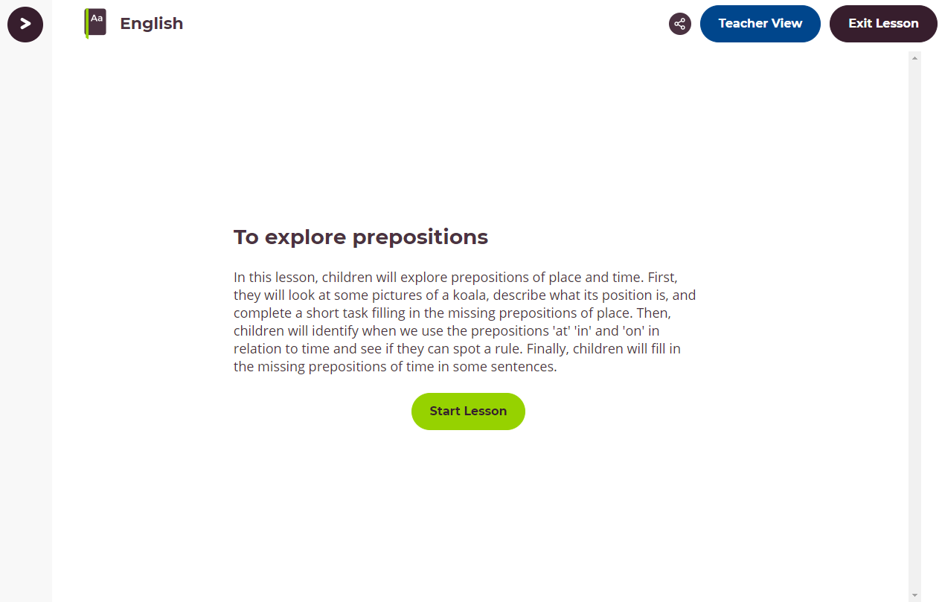
ENGLISH LESSON 2 - GRAMMAR LESSON
For your Grammar lesson today we would like you to complete this lesson from the Oak Academy website.
To explore prepositions:
In this lesson, children will explore prepositions of place and time. First, they will look at some pictures of a koala, describe what its position is, and complete a short task filling in the missing prepositions of place. Then, children will identify when we use the prepositions 'at' 'in' and 'on' in relation to time and see if they can spot a rule. Finally, children will fill in the missing prepositions of time in some sentences.
CLICK ON THE IMAGE TO GO TO THE WEBSITE
LINK

Slide 6
FRENCH GAMES
As part of your French lessons with Mrs Pond you have been practising your French using these games below.
Please use the links to continue to practise your French.
Numbers 1-31 https://wordwall.net/resource/10683527/french/french-numbers-1-31
Days of the week https://wordwall.net/resource/3874515/french/days-week-french
Months of the year https://wordwall.net/resource/9919076/french/year-1-months-year-french
Greetings https://wordwall.net/resource/4928088/french/french-greetings
https://wordwall.net/resource/4285570/french/greetings-french-facile
Saying your age https://wordwall.net/resource/13367932/how-old-you
This has also been set through Google Classroom if you would like to log in that way.

Slide 7
MUSIC LESSON
Mrs Chilver has set you a little musical challenge - GOOD LUCK!
YOUR CHALLENGE:
Write a song for a car advert.
Using the tune to Frere Jacques change the words to sell your favourite car.
When you have the song, add sound effects from the BBC Sound Effect Library.
Search vehicles to find the best sounds. You could make a mix like we did with nature sounds.
You could record yourself singing with the sound effects in the background.
Frère Jacques (Instrumental): https://www.youtube.com/watch?v=6-JoTos8-oE
BBC Sound effects website: https://sound-effects.bbcrewind.co.uk/
This has also been set through Google Classroom if you would like to log in that way.

